Slide 1
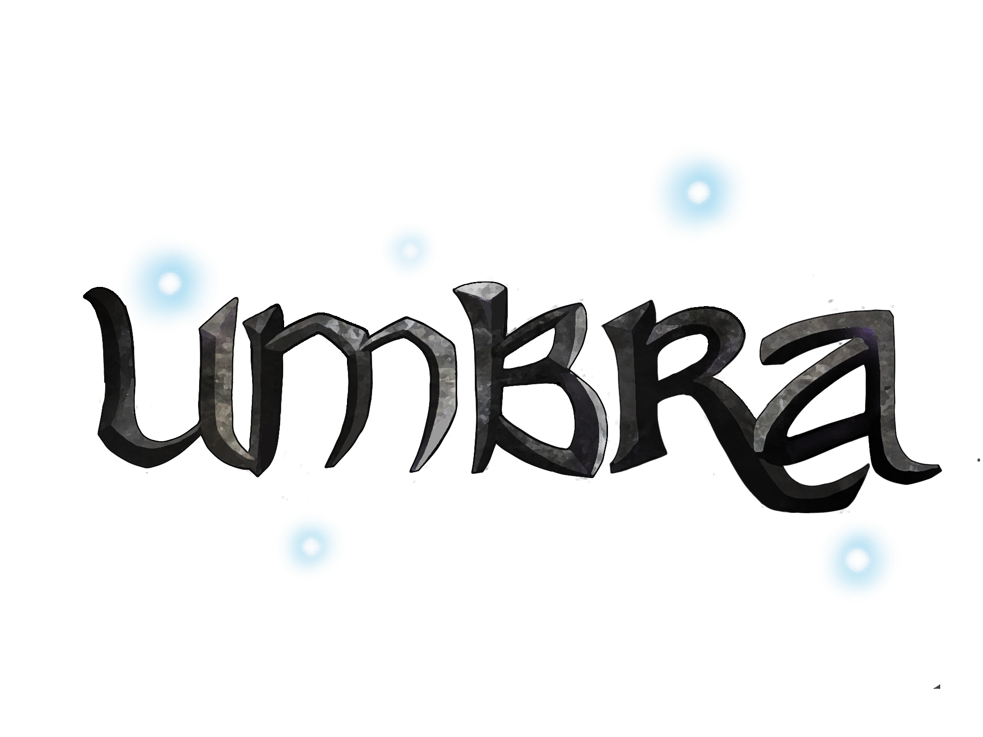


Game by:
All content © copyright 2019, DigiPen Institute of Technology

Slide 2
Team Roster
Brayan Lopez (RTIS)
Producer
Gameplay Programmer
Christine Medina (BFA)
Game Director
Zach Rammell (BSCS)
Tech Lead
Engine Programmer
Sophia Wang (BFA)
Art Lead
Character Artist /Animator
Zach Rammell (BSCS)
Level Designer
Hadi Alhussieni (RTIS)
Graphics Programmer
Christine Medina (BFA)
Props/UI Artist
VFX Animator
Michael Rollosson Halbhuber (BSGD)
Designer
Chau Nguyen (RTIS)
Graphics Programmer
Julyanne Spragg (BFA)
Creature Artist
Creature Animator
Tony Qian (BSGD)
Physics Programmer
Chelsea Liang (BFA)
Environment/Props Artist
Michael Rollosson Halbhuber (BSGD)
Tools Programmer

Slide 3
Game Description
Project Umbra is a fluid fast-paced 2D action-adventure platformer with physics-based aerial movement and dynamically lit environments in which the player must battle horrifying monsters and banish the darkness.

Slide 4
Gameplay
The player traverses through the terrain and to battle the monsters in their way by dashing and diveslamming.
Along the way, they light lanterns to ward off the darkness, which is able to physically hurt them and make it hard to see.
Their goal is to get to the end of the level to light the crystal container to ward off the monsters from the cave permanently.
Attack:
Dashing
Dive bomb
Obstacles:
Darkness
Monsters
Goal:
Get to the end to light brazier.

Slide 5
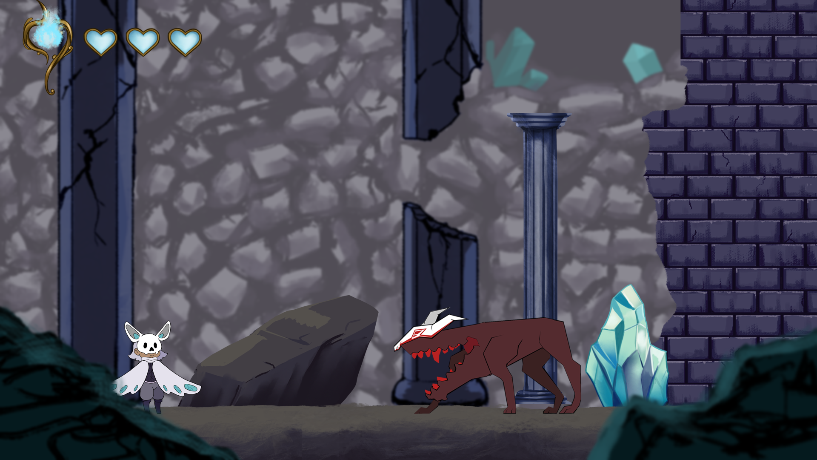
Mock Screenshot

Slide 6
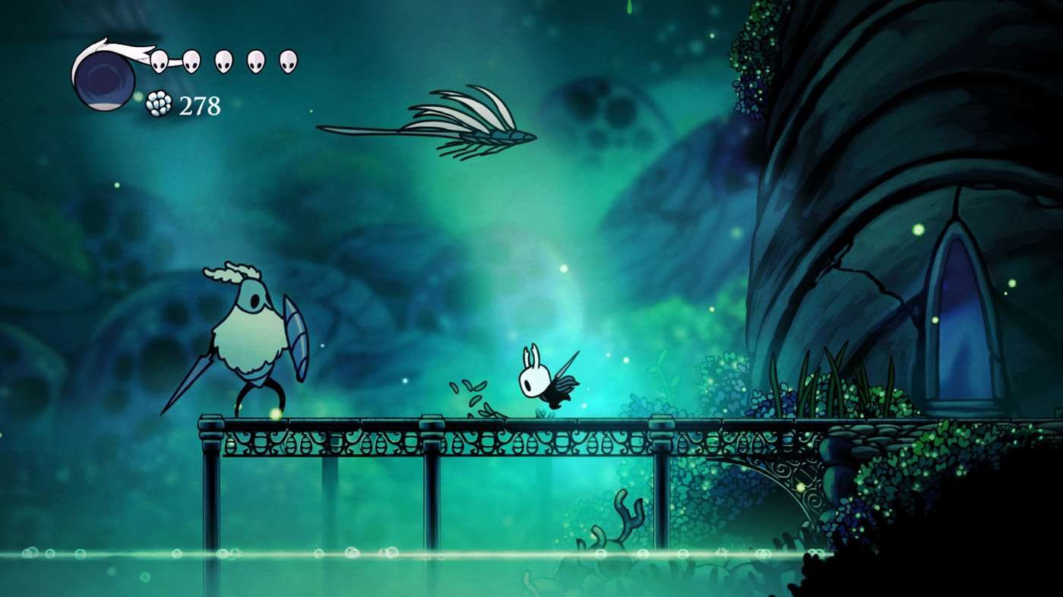
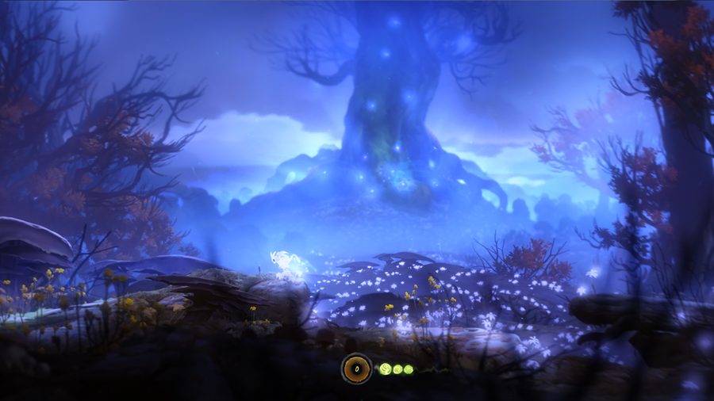
Style Influences
@HollowKnight_TeamCherry_2017
Heavy atmospheric perspective to increase sense of depth
Light character against dark background
Environment takes on a painted style with bold silhouettes
Distinct silhouettes to have characters stand out from the background.
Strong black linework and simple designs for characters
@OriAndTheBlindForest_MoonStudios_2015

Slide 7
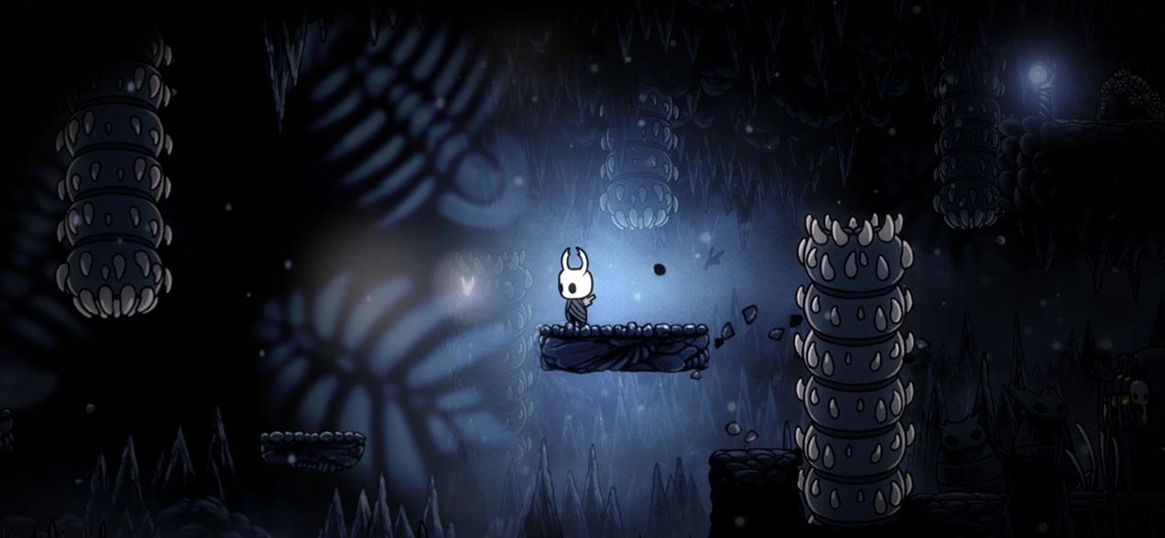
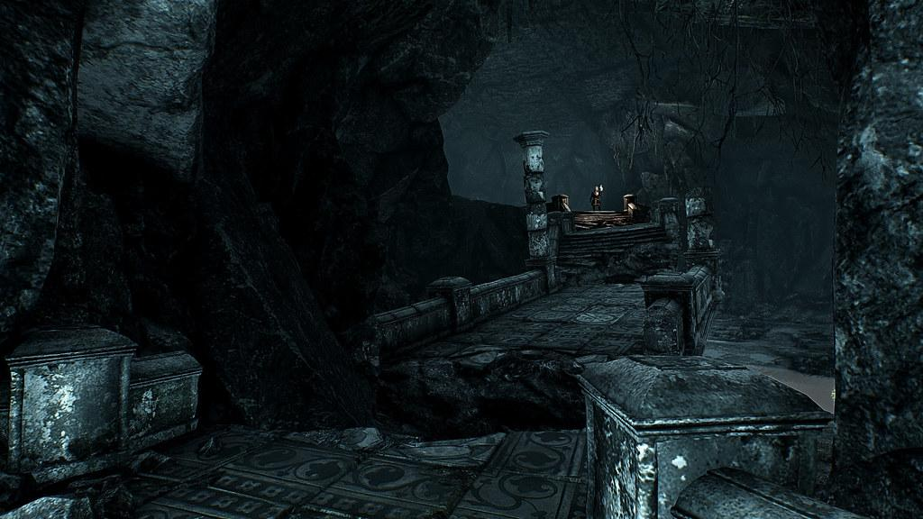
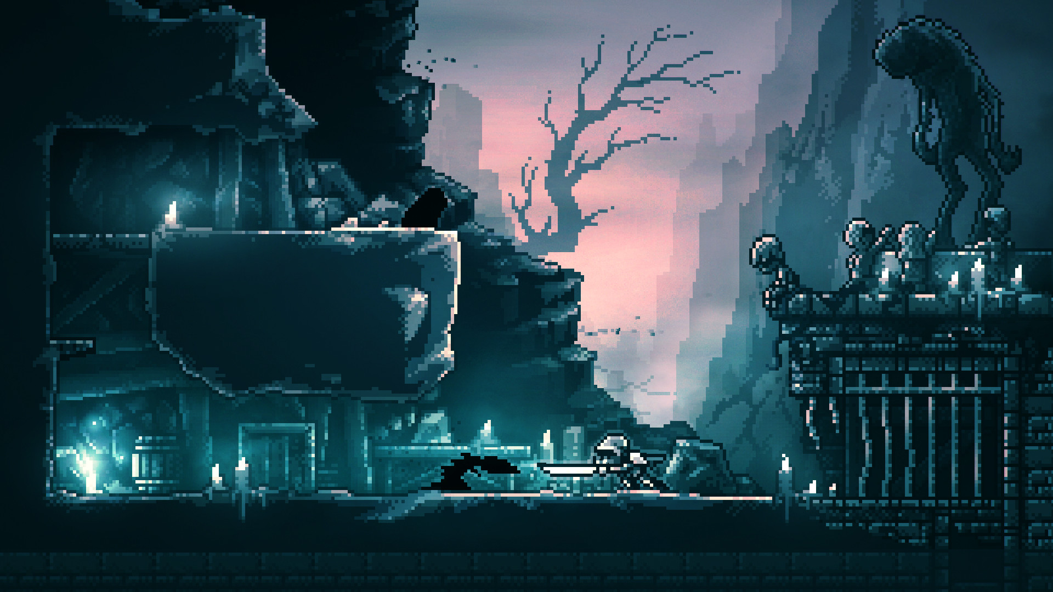
Mood and Tone Reference
@HollowKnight_TeamCherry_2017
@TheWitcher3TheWildHunt_CDProjektRed_2015
@Inmost_HiddenLayerGames_2019
The game atmosphere should create a sense of loneliness in a dangerous world.
The overall mood is that it’s grim and gloomy, but ancient and sacred at the same time.

Slide 8
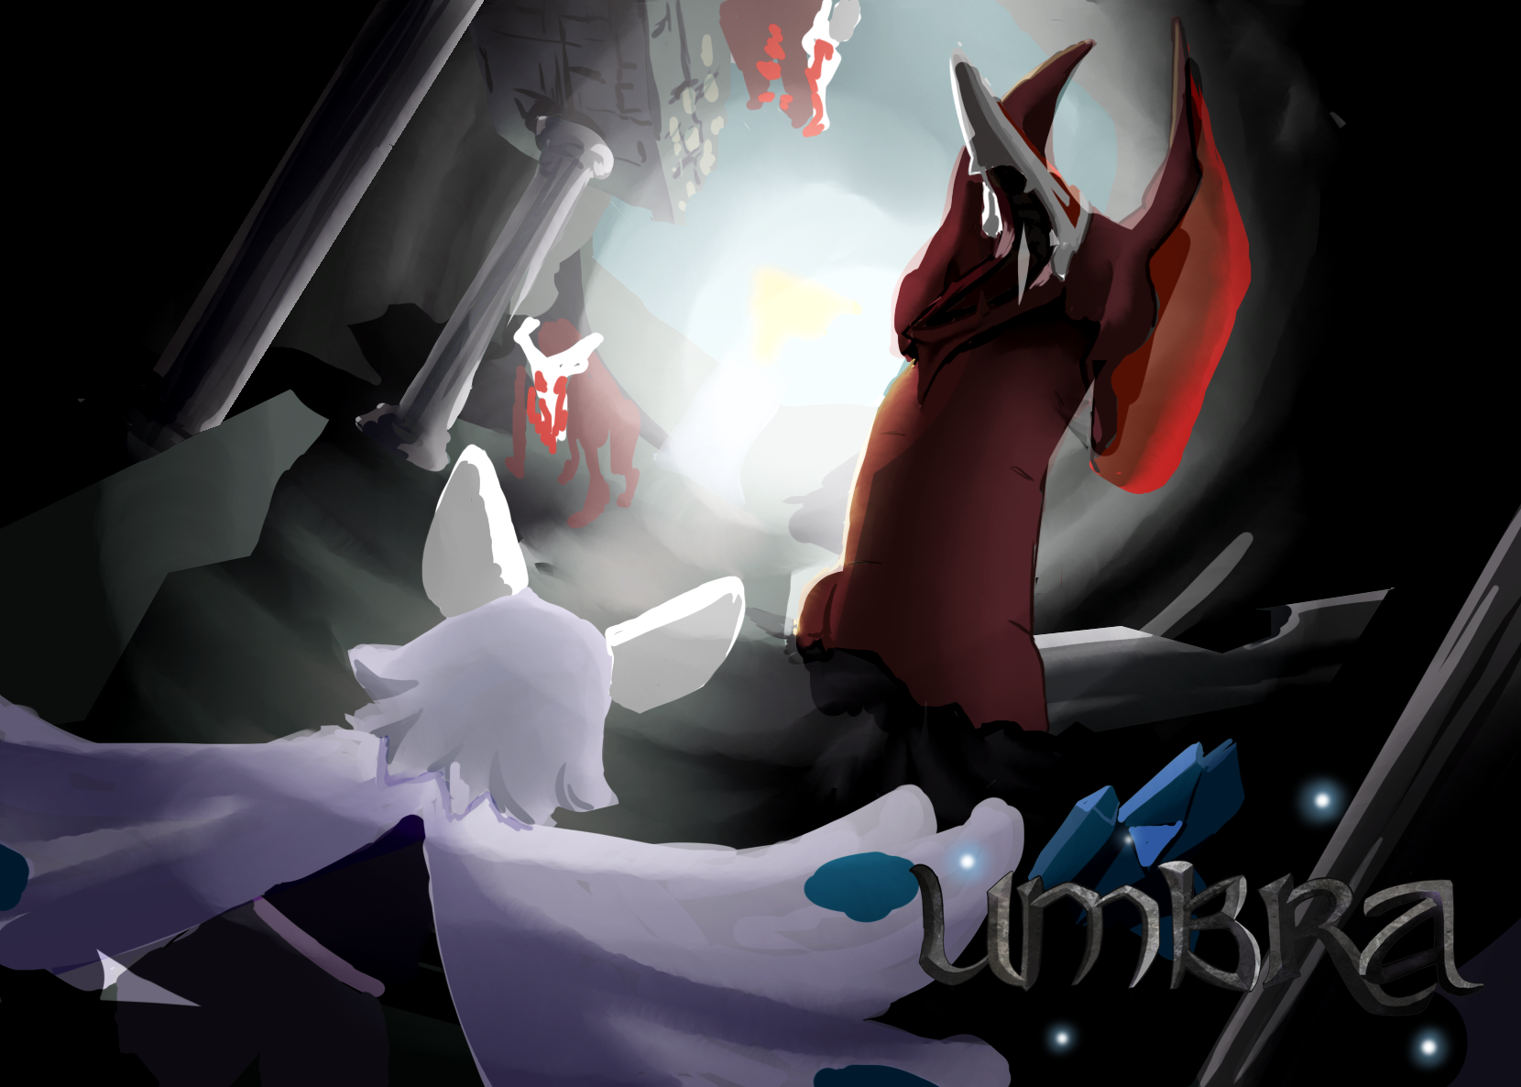
Key Splash Screen
Notes:
Needs blocked in UI for splash screen

Slide 9
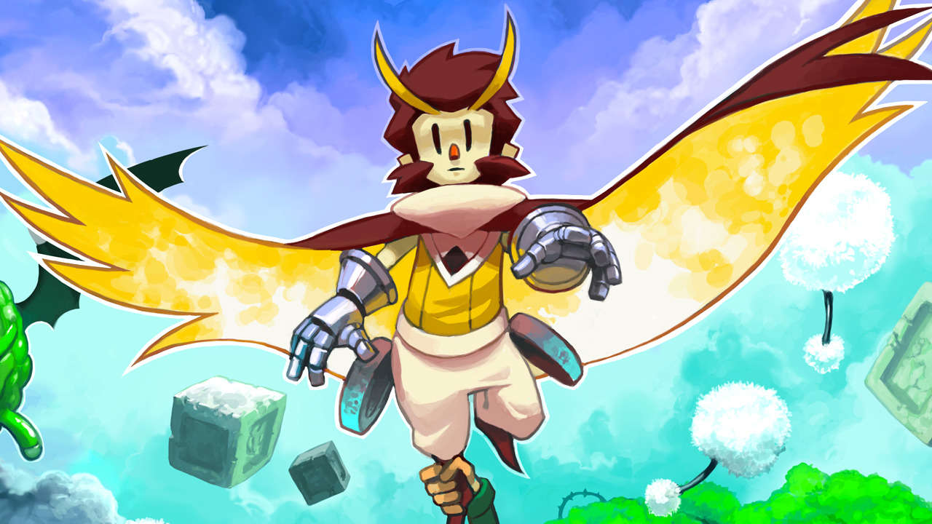
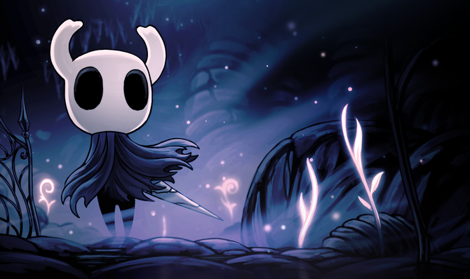
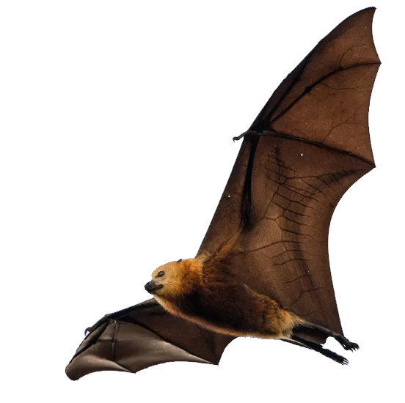
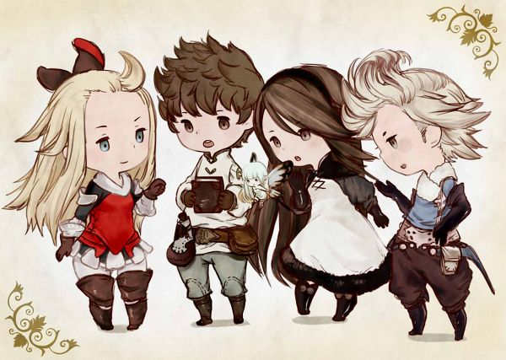
Character References
@Owlboy_D-Pad Studio_2016
@HollowKnight_TeamCherry_2017
The character should have the proportions of a child to emphasize the cuteness factor
This also means they need to be composed of round shapes, not menacing
They should be bat like to fit the underground cave temple setting they are in
@BravelyDefault_SquareEnix_2012

Slide 10
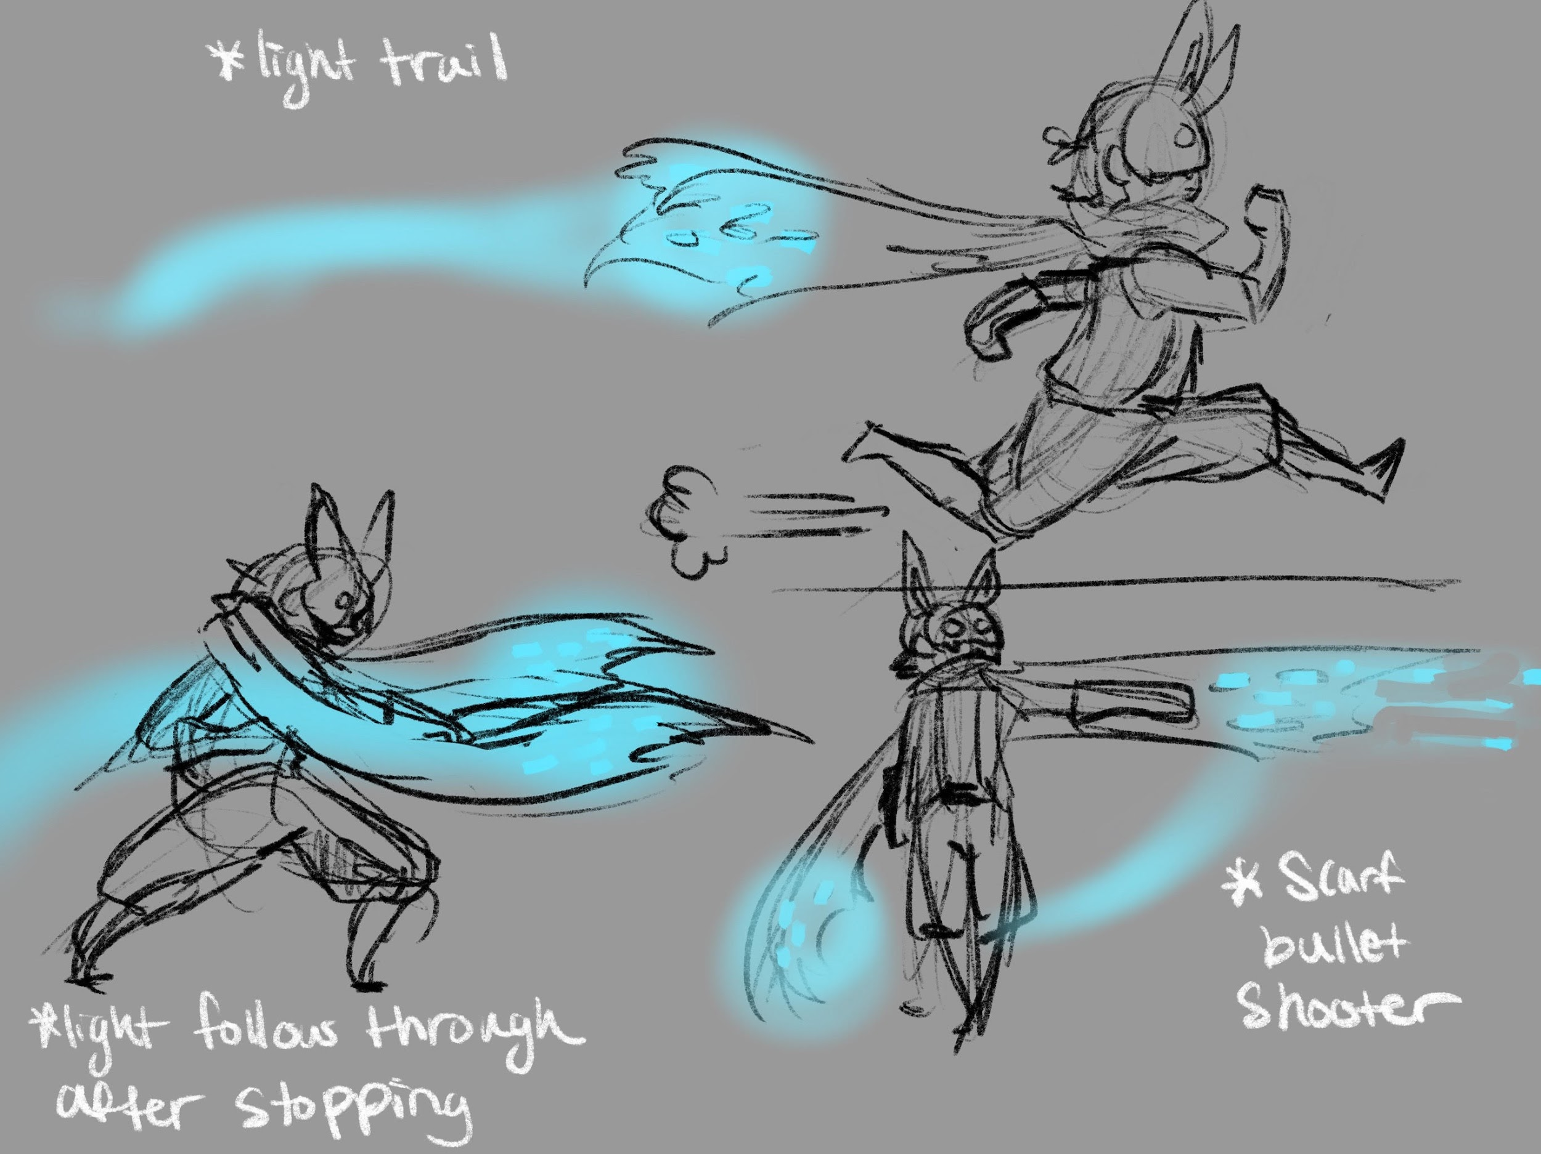
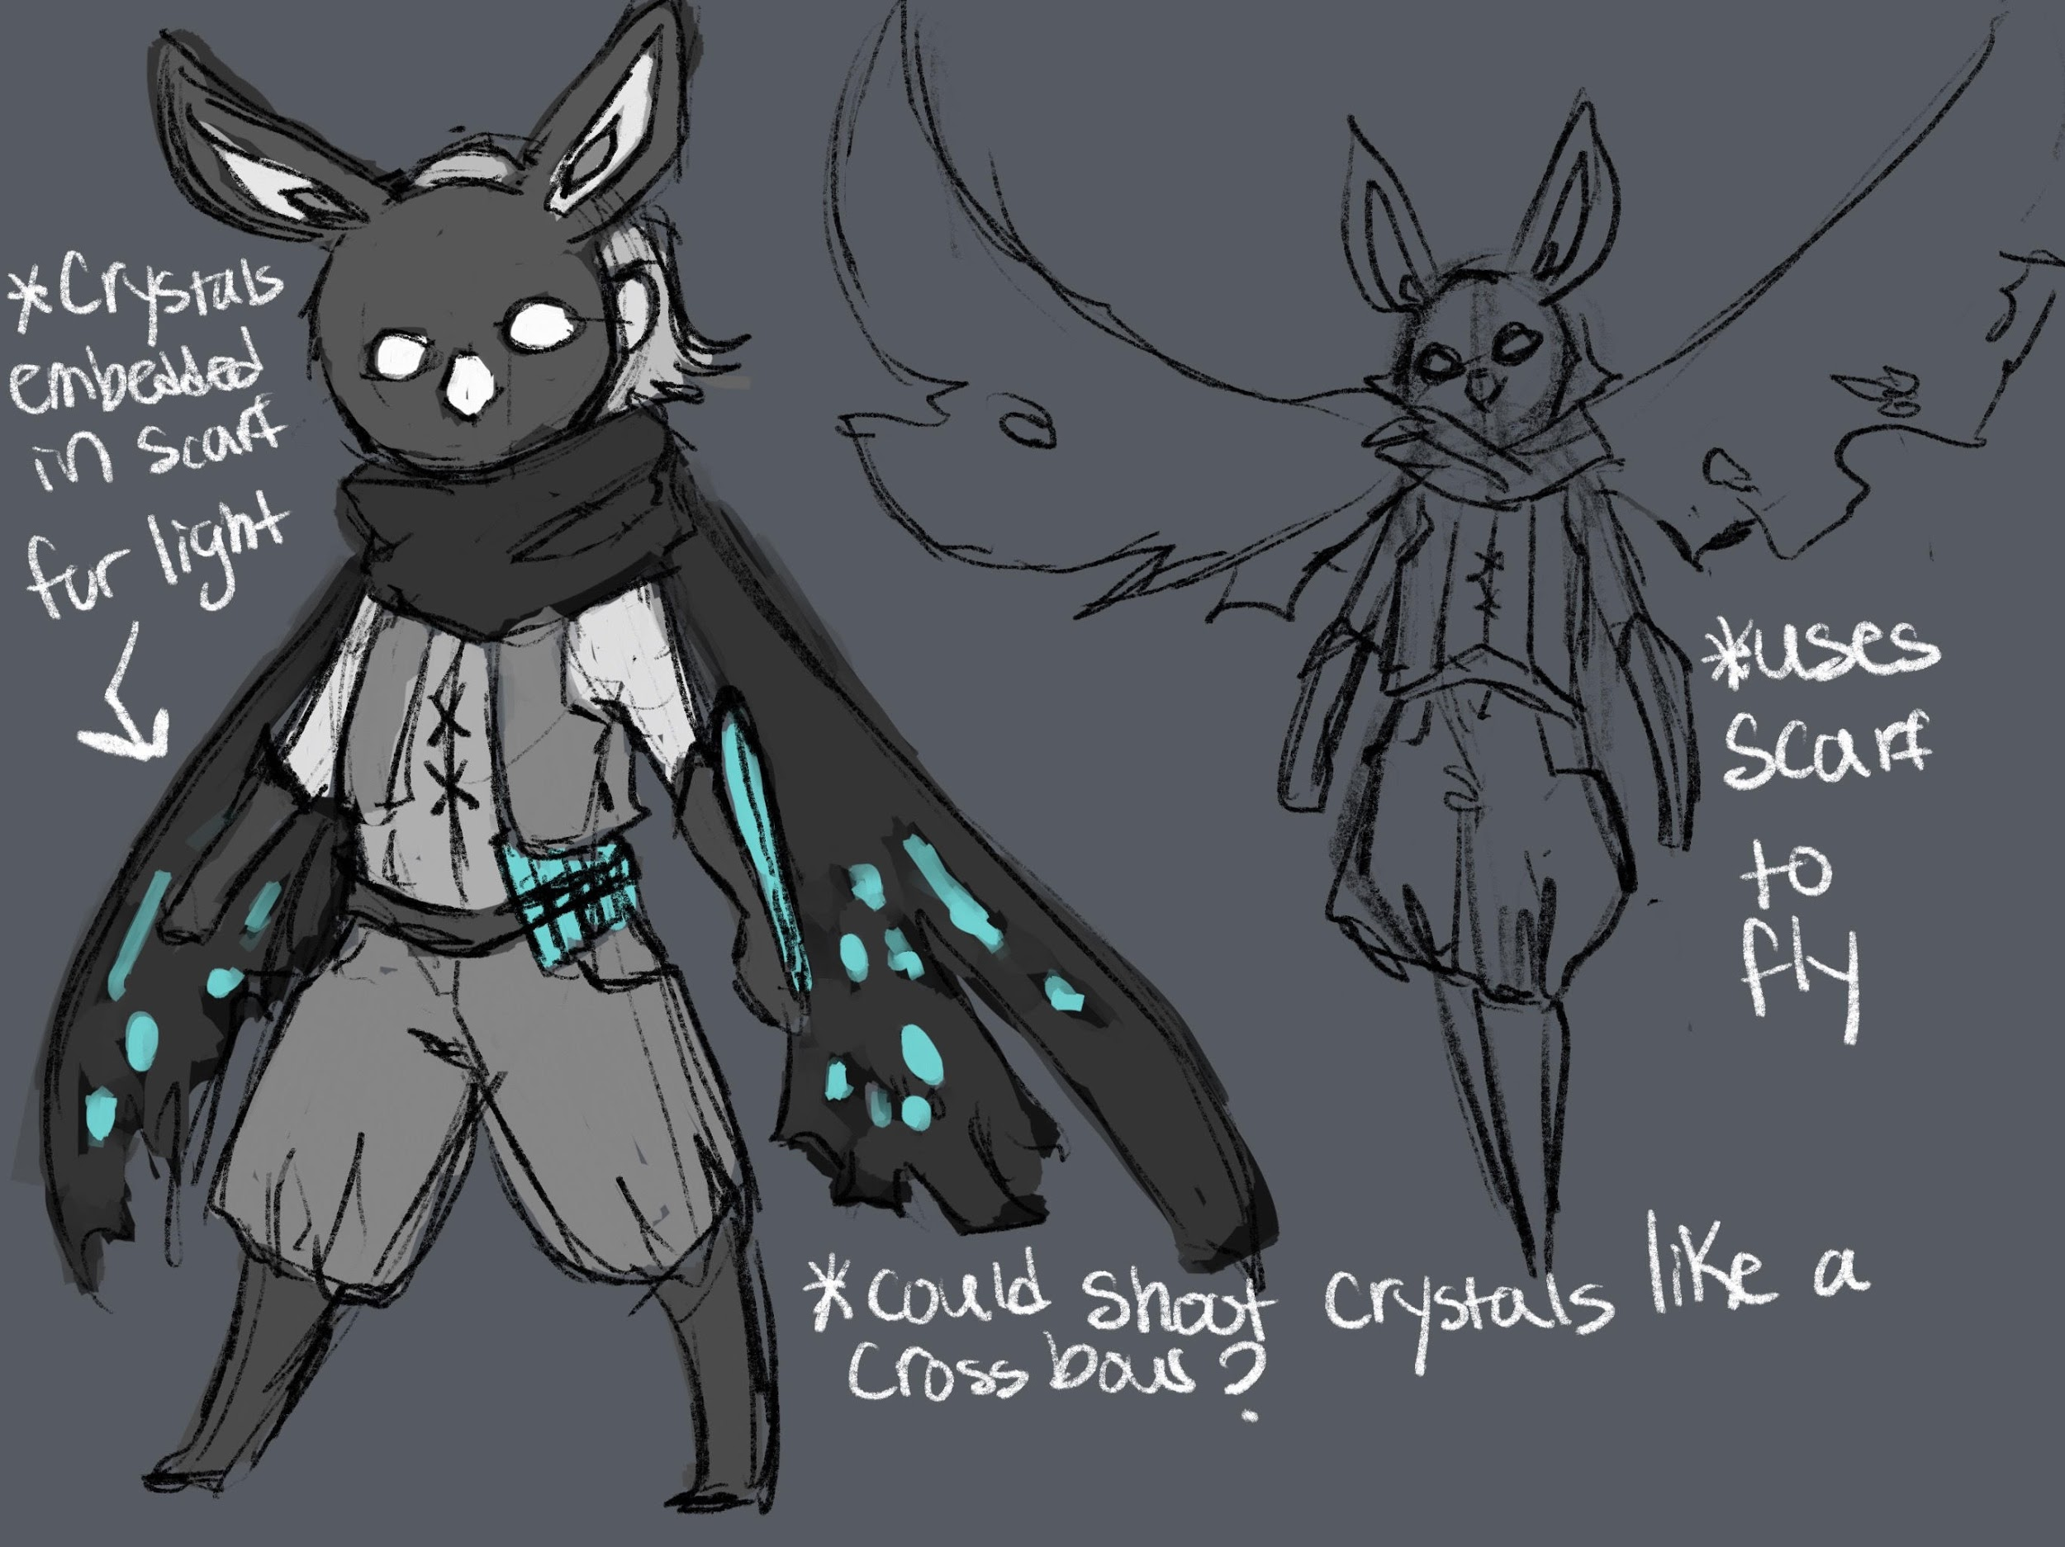
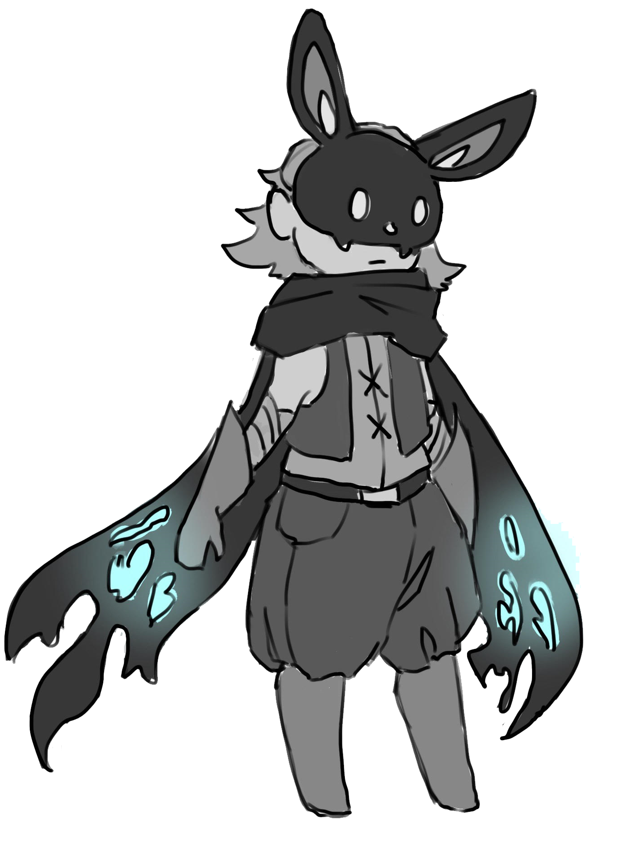
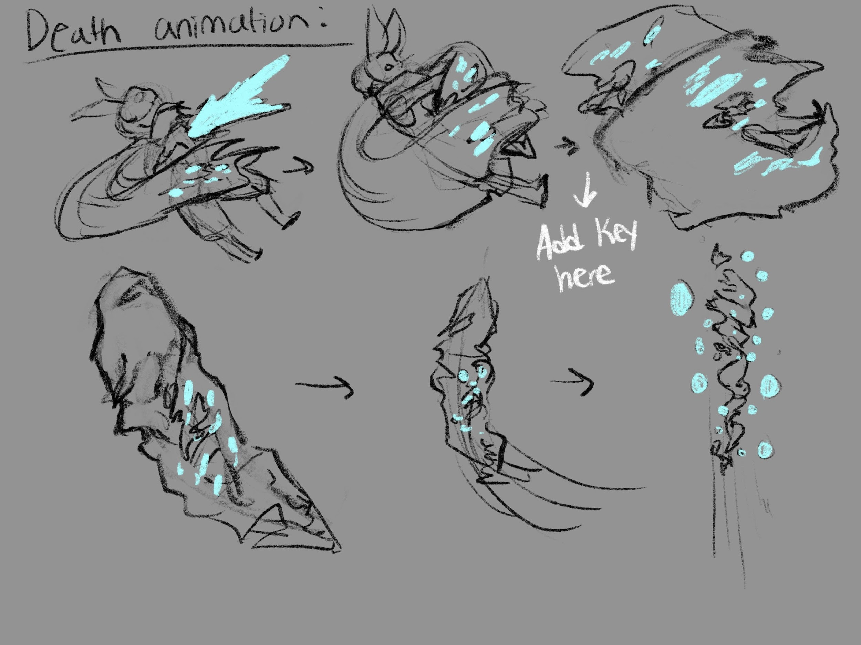
Character Concepts
Sight is bat like child whose job is to relight the brazier in the temple
Early concepts involved having a sentient scarf that lights up the temple
Scarf would be the main weapon for attacking
It was eventually combined with the arms to lessen the animation effort
…

Slide 11
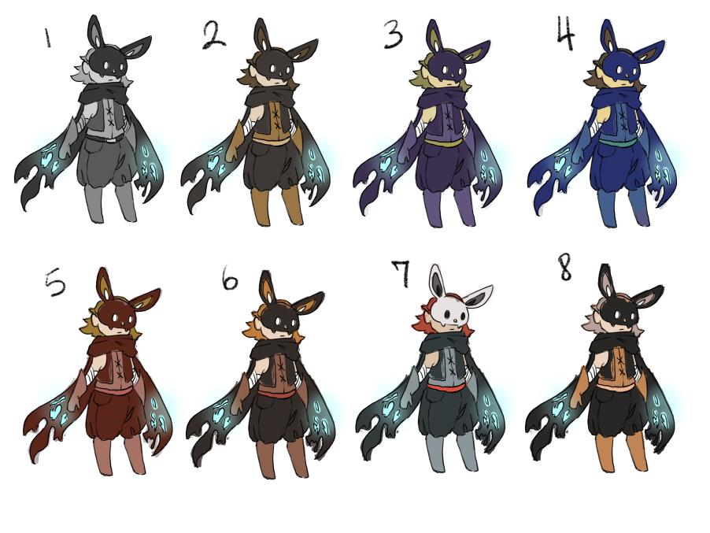
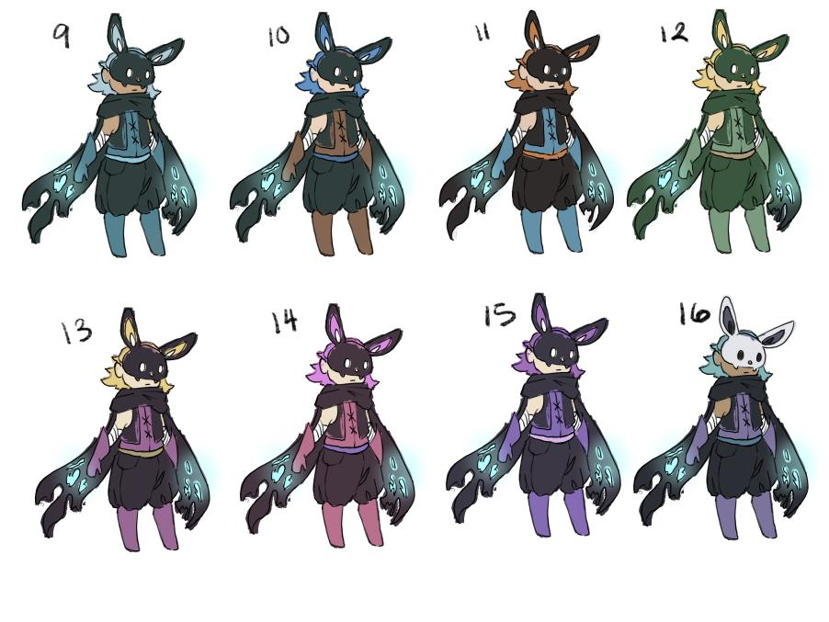
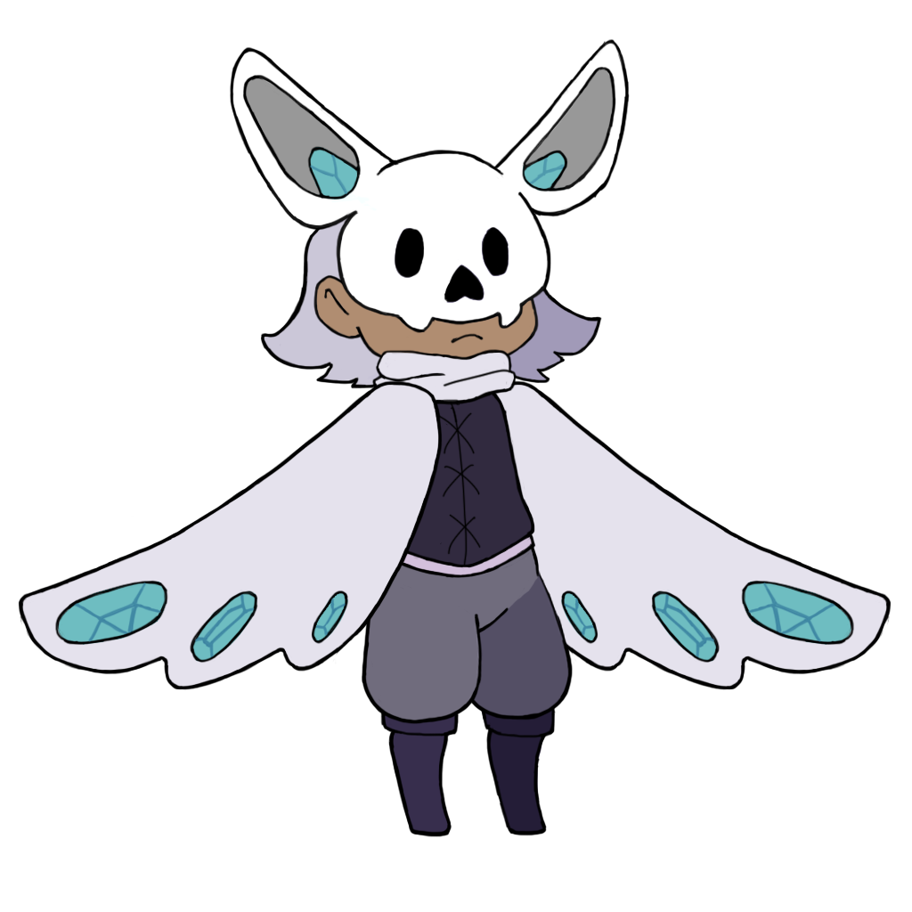
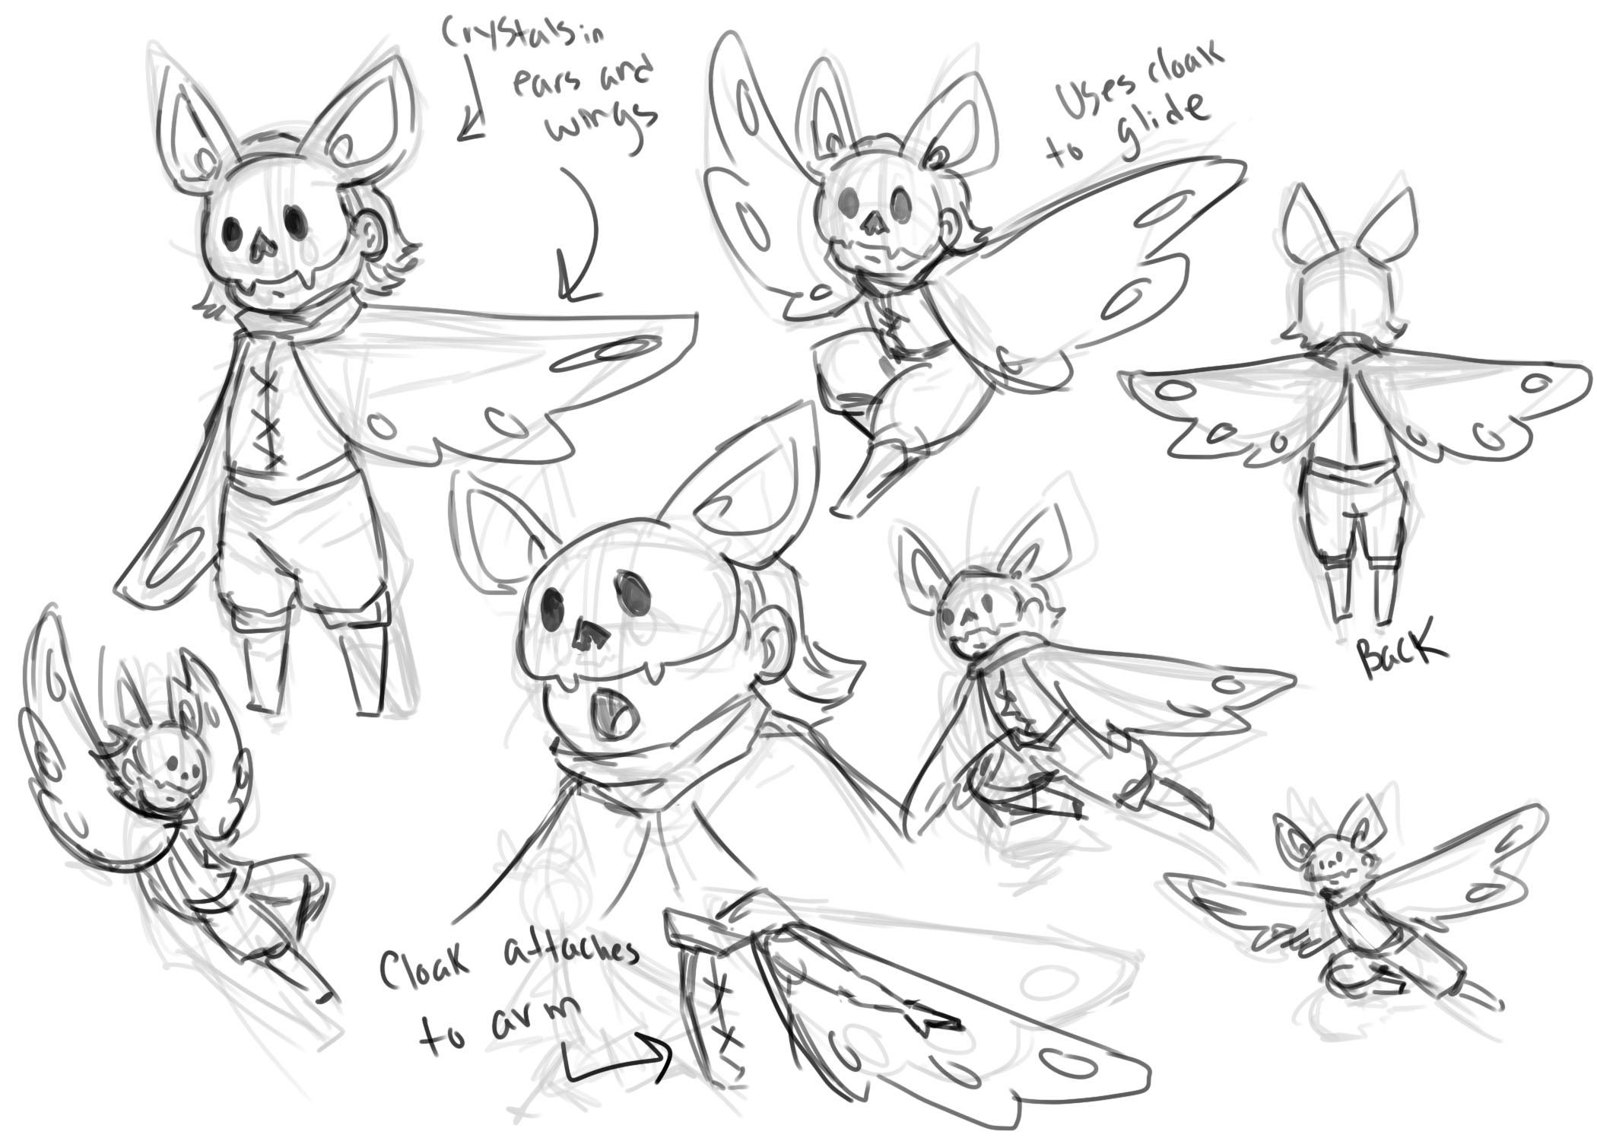
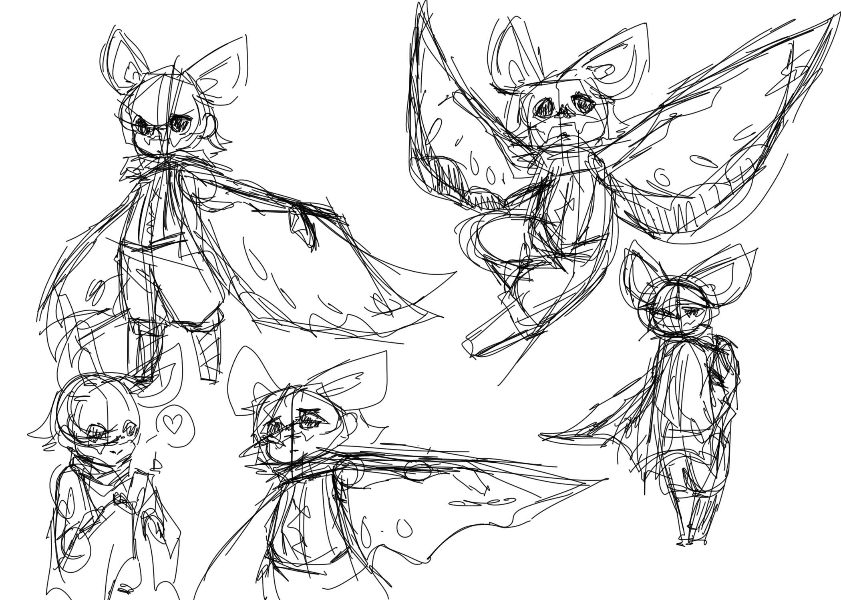
Character
“Sight”
The wing cloak allows them to jump and glide
Crystals infused in the cloak to damage creatures
Crystals are used to relight the lanterns and brazier
Mask has crystals for more light and allow character to be more visible
Purple palette compliments the blue crystals and contrasts the red palette of the creatures

Slide 12
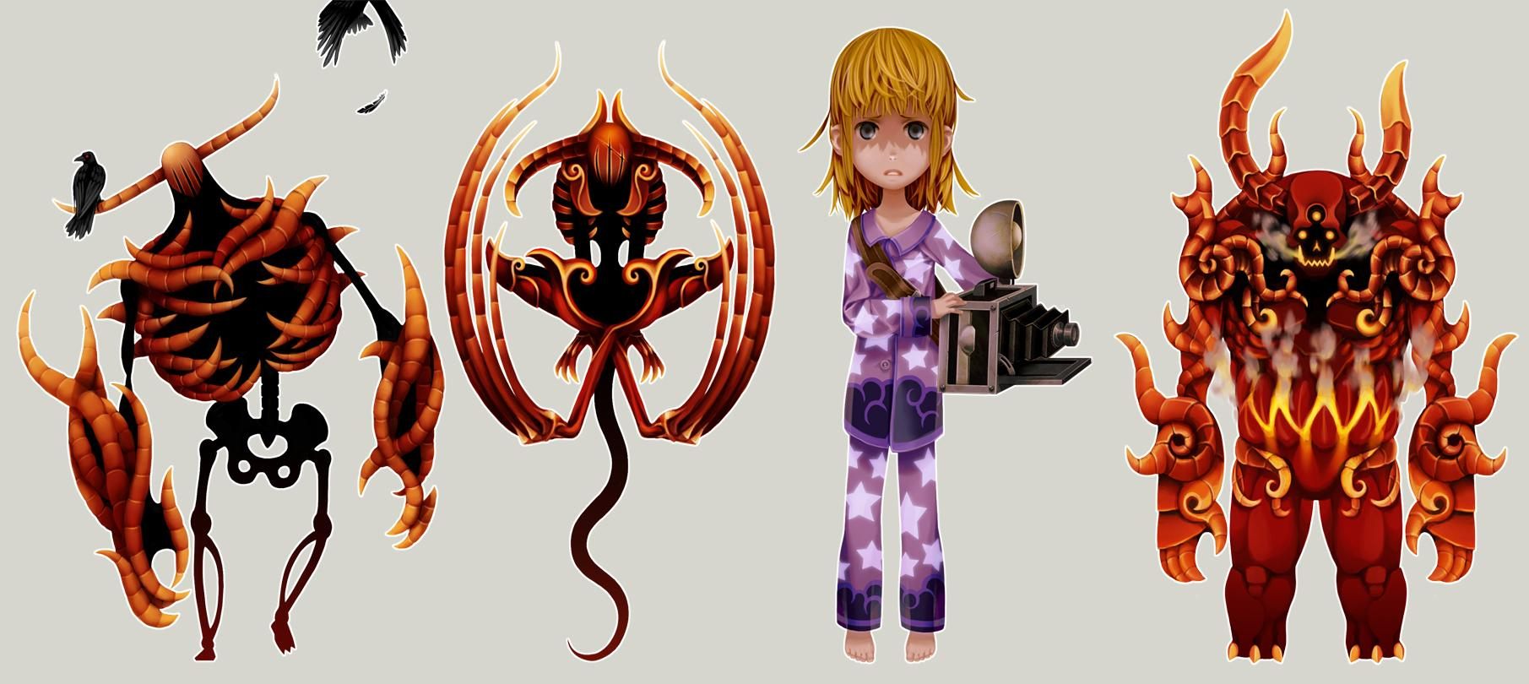
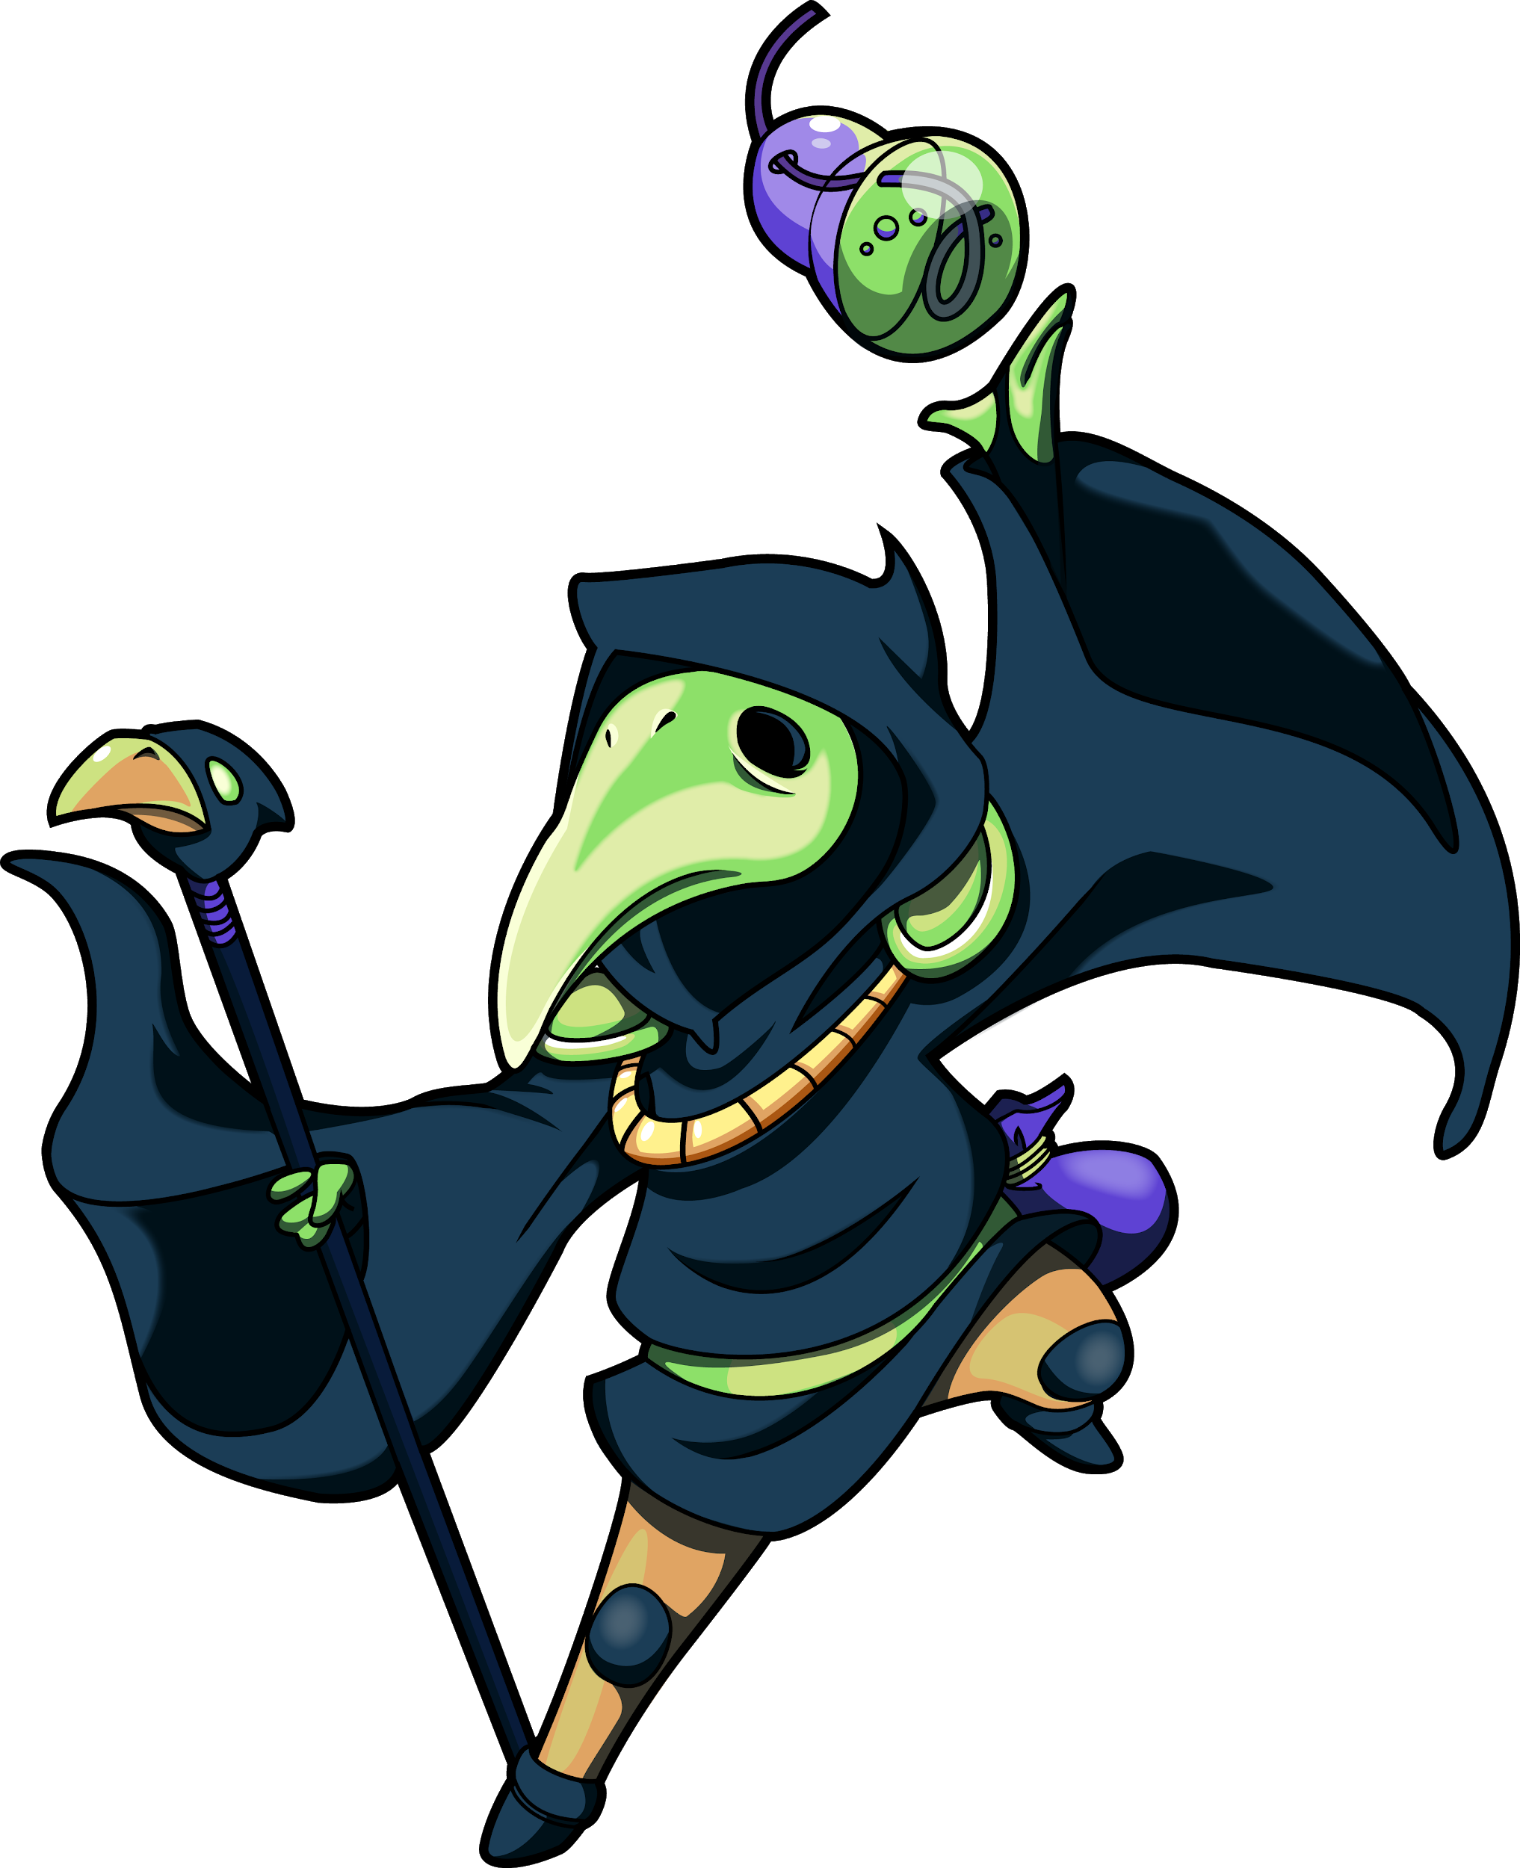
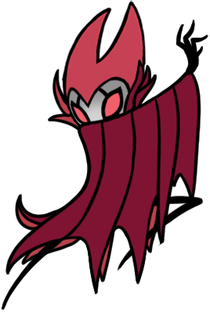
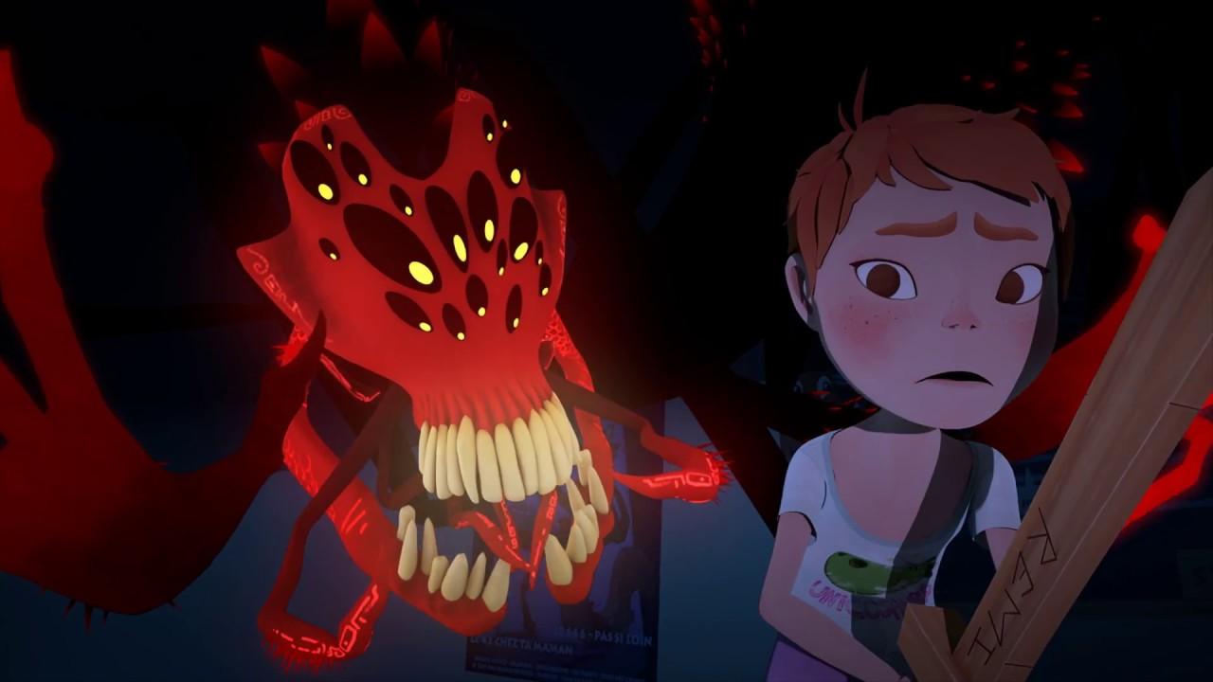
Creature References
Color pallet has changed from saturated cyan and black hue to more desaturated crimson and magenta.
Choice of images represent the thick line work but also a more angler and sharp.
Compared to the soft and round lines of the character
To avoid confusion in the crystals and foes appart. Color of glow on enemies changed to red. To give a more threatening
appearance .
@Lumen_Thousandstudios Cranes_2013
@Claire Obscur_ClaireObscurTeam_2017
@HollowKnight_TeamCherry_2017
@ShovelKnight_ Yacht Club _2014

Slide 13
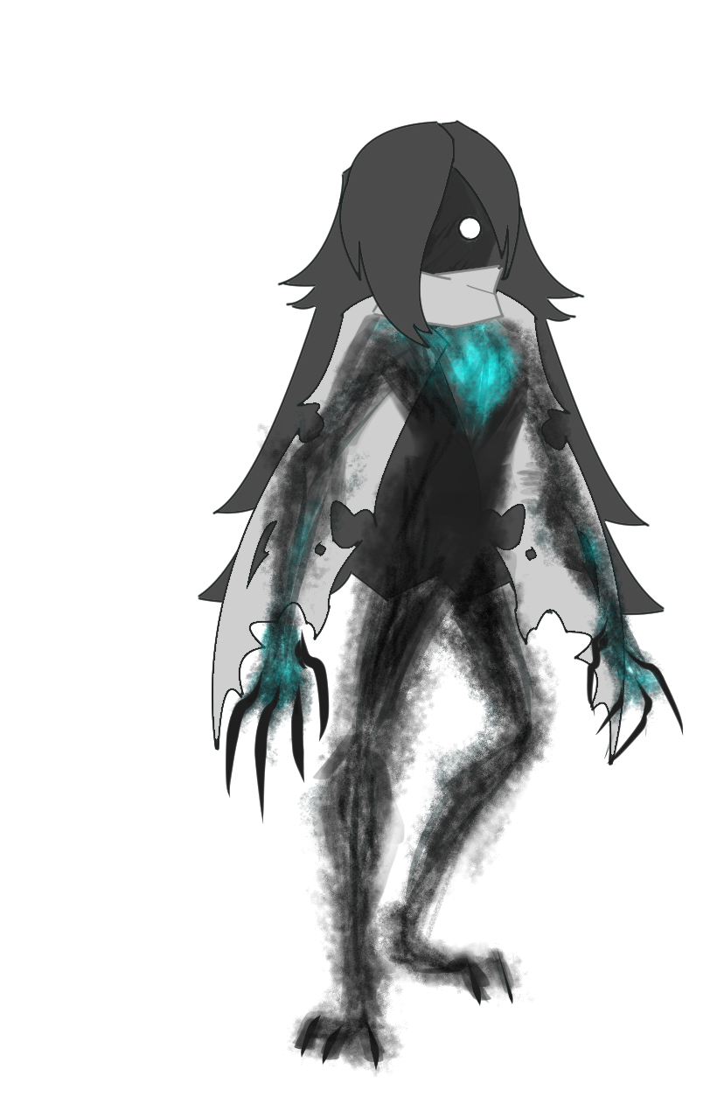
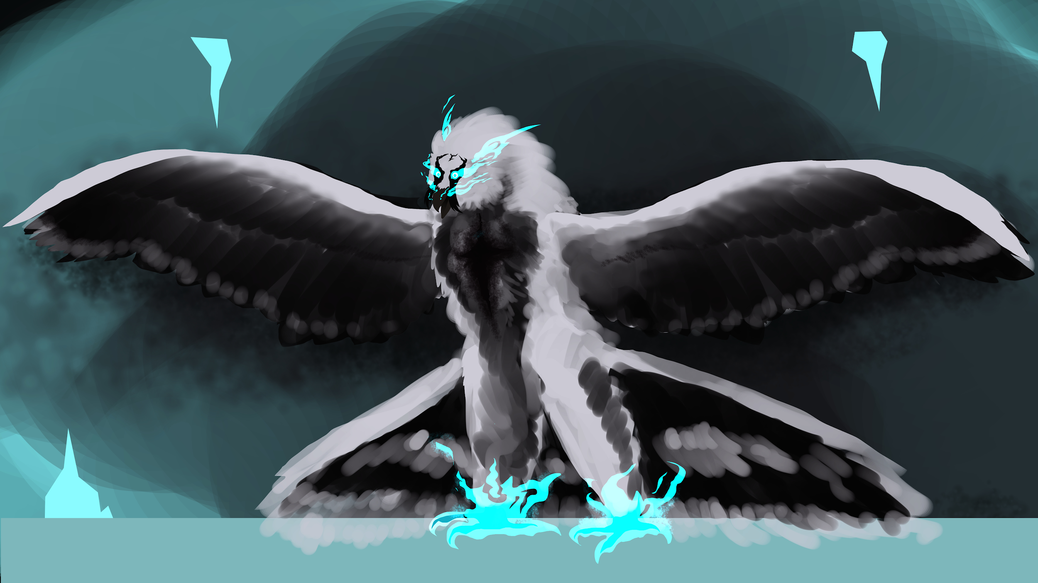
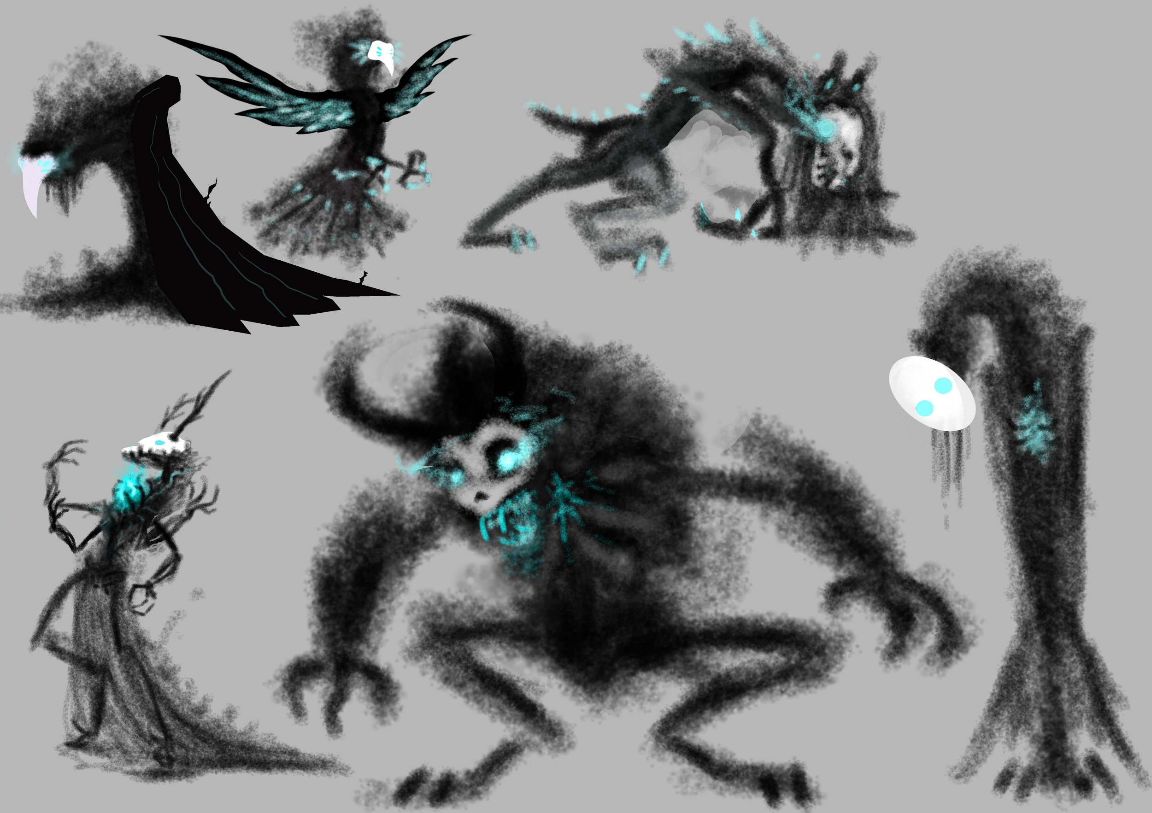
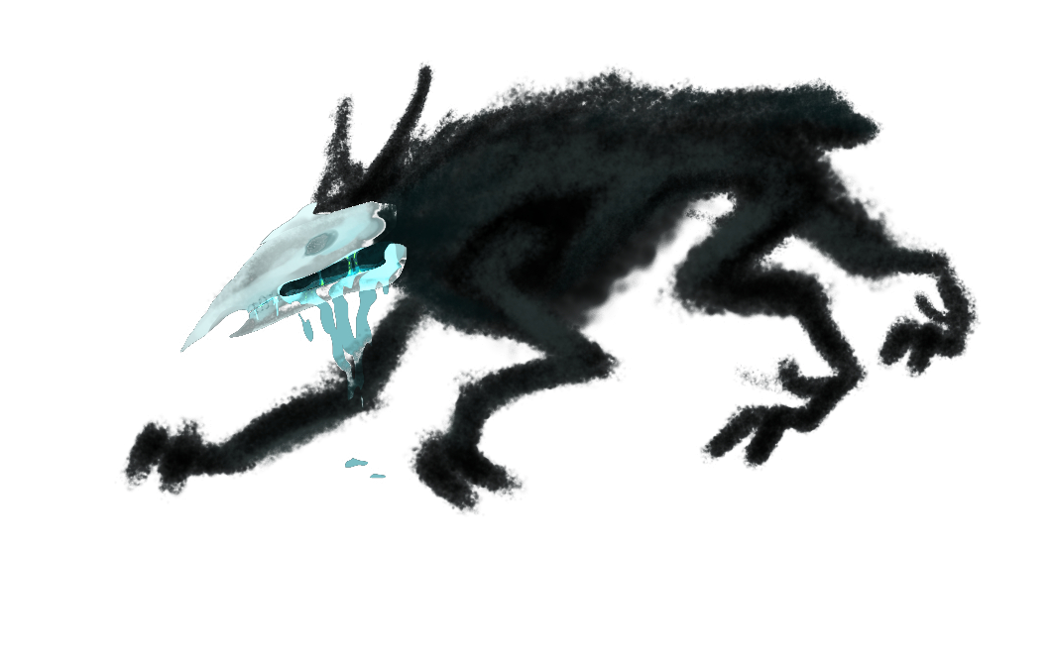
Creature Concepts
Origin: Creatures were black and cyan to have an eerie tone.
Wispy and entirely made of “shadow.” A phantom like aura.

Slide 14
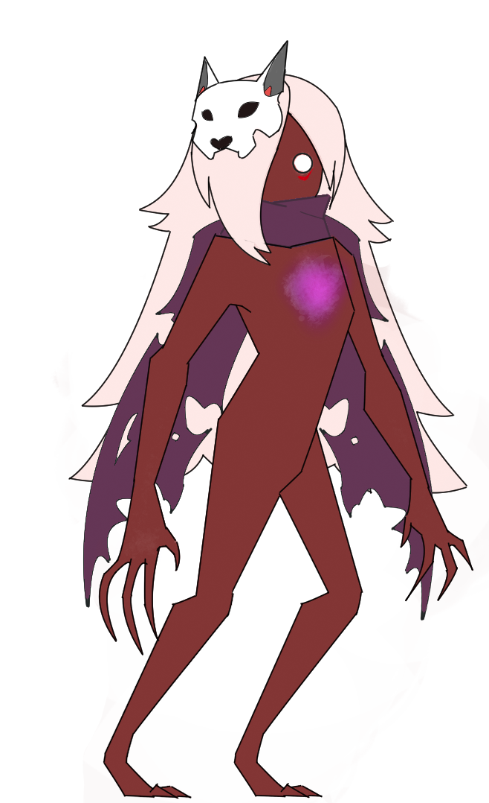
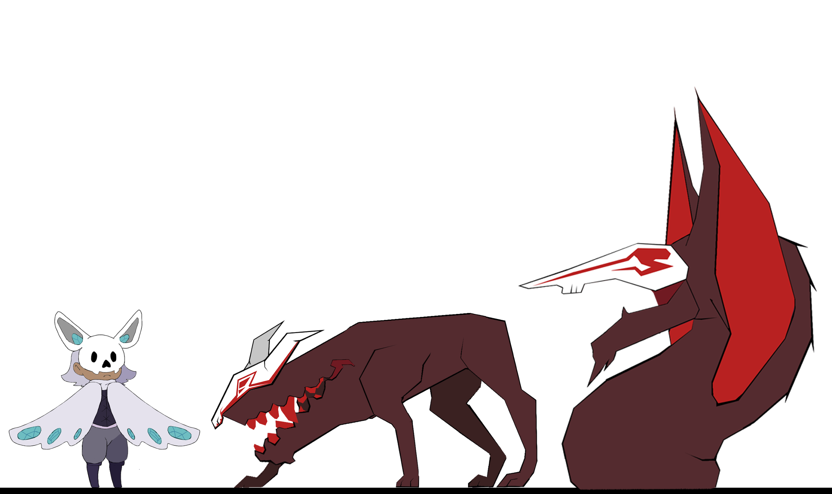
Creatures
To avoid confusion from crystals changed the color pallet to be more menicining.
Emphasis on more angler line work and
Illuminated areas on creatures.
Touch
Hearing
Taste

Slide 15
Scale Comparison

Slide 16
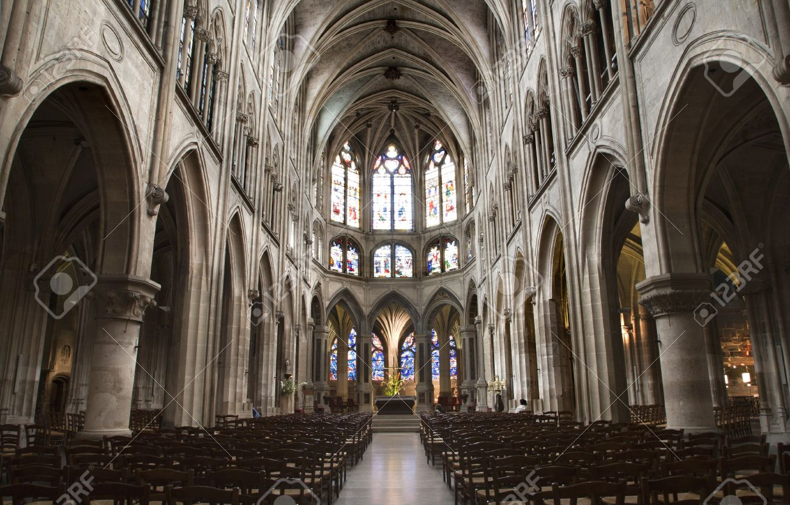
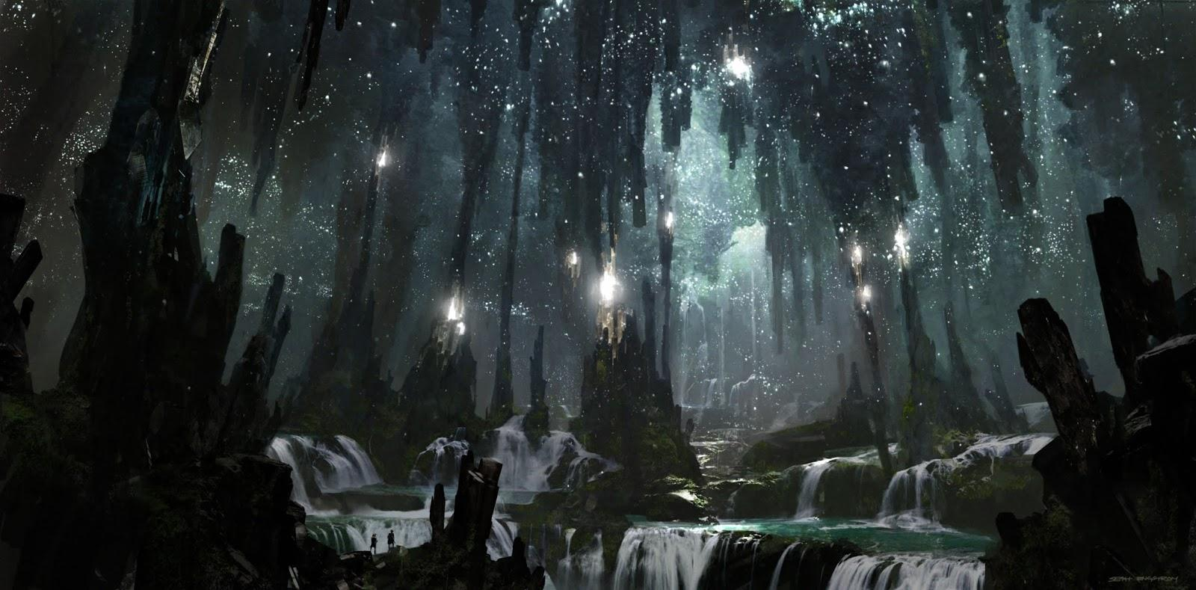
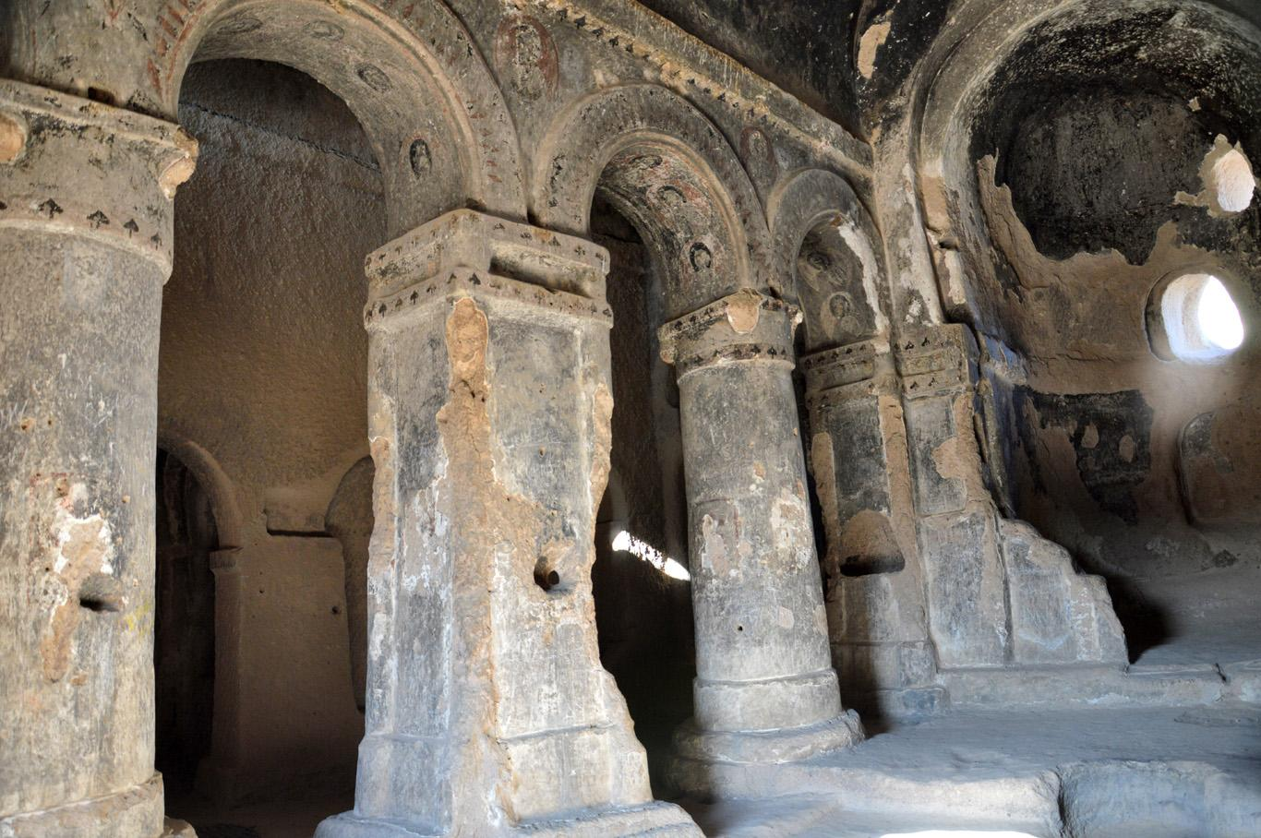
Environment References
We wanted to make the environment like ruins in cave
Background elements looming and making the player feel small compared to the environment
Mixture of both organic and artificial elements in background (stalactites vs pillars, etc.)
Not perfect, things are in shambles, but giving off the eerie, somber vibes
Not exactly human civilization
Notes:
We wanted to make the environment like ruins in cave
Background elements looming and making the player feel small compared to the environment
Mixture of both organic and artificial elements in background (stalactites vs pillars, etc etc)
Not perfect, things are in shambles, but giving off the eerie, somber vibes
Not exactly human civilization

Slide 17
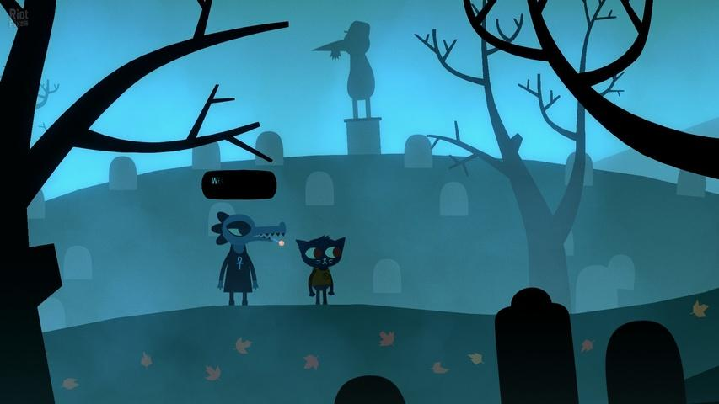
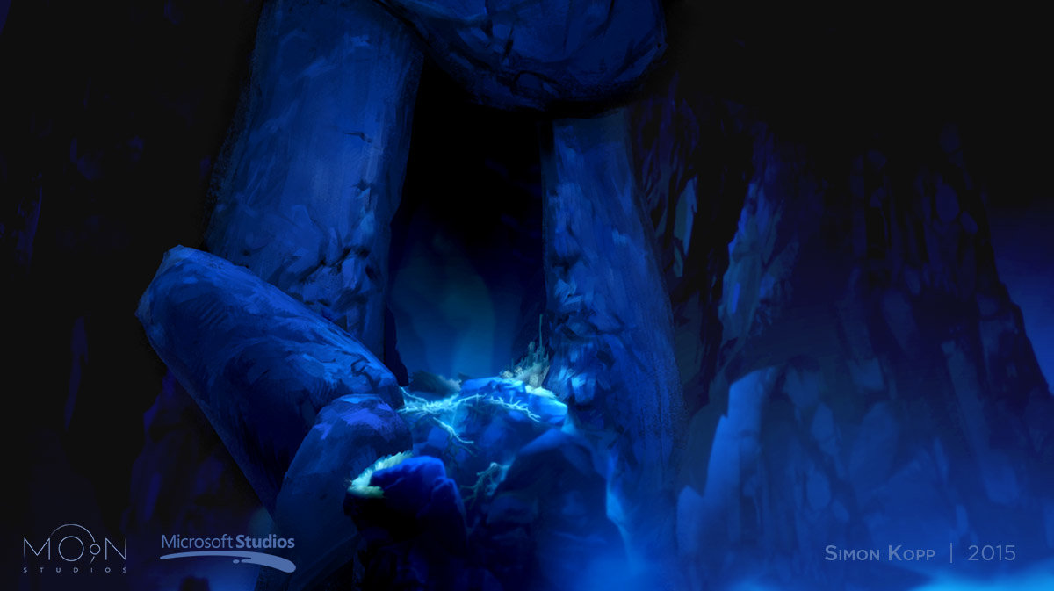
Environment References
@Night in the Woods_Infinite Fall Team_2017
@Ori in the Blind Forest_Moon Studios_2015
Simple, clear silhouettes and shapes of background elements
Distinguishable from the character, more focus on painting strokes and textures
3 value painting style with implied detail, parallaxing layers are visibly different from each other
Dynamic lighting emphasis
Notes:
-Simple, clear silhouettes and shapes of background elements
-Distinguishable from the character, more focus on painting strokes and textures
-3 value painting style with implied detail, parallaxing layers are visibly different from each other
-dynamic lighting emphasis

Slide 18
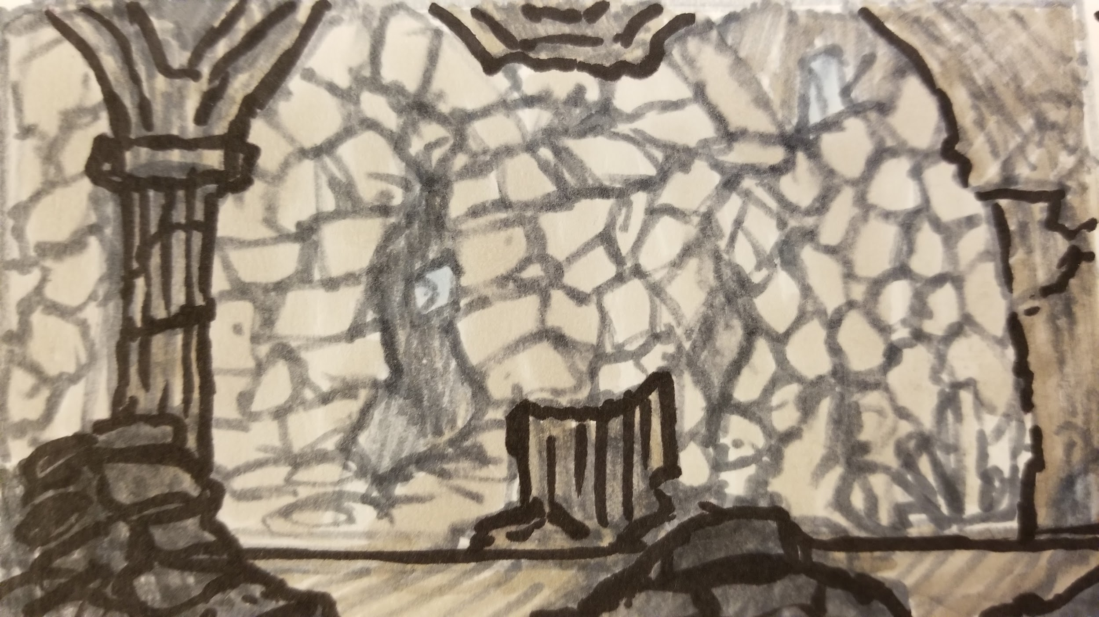
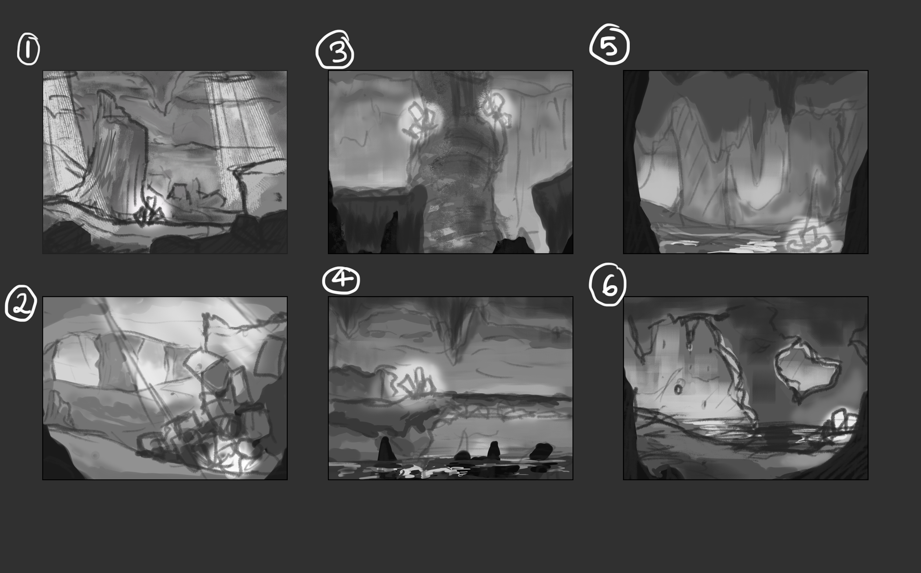
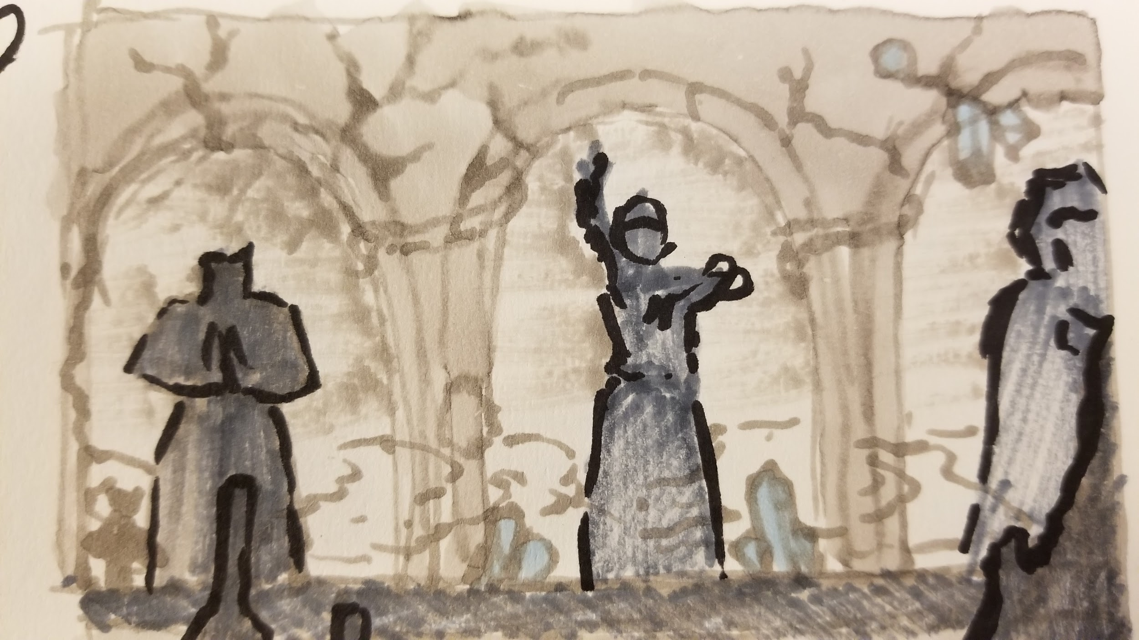
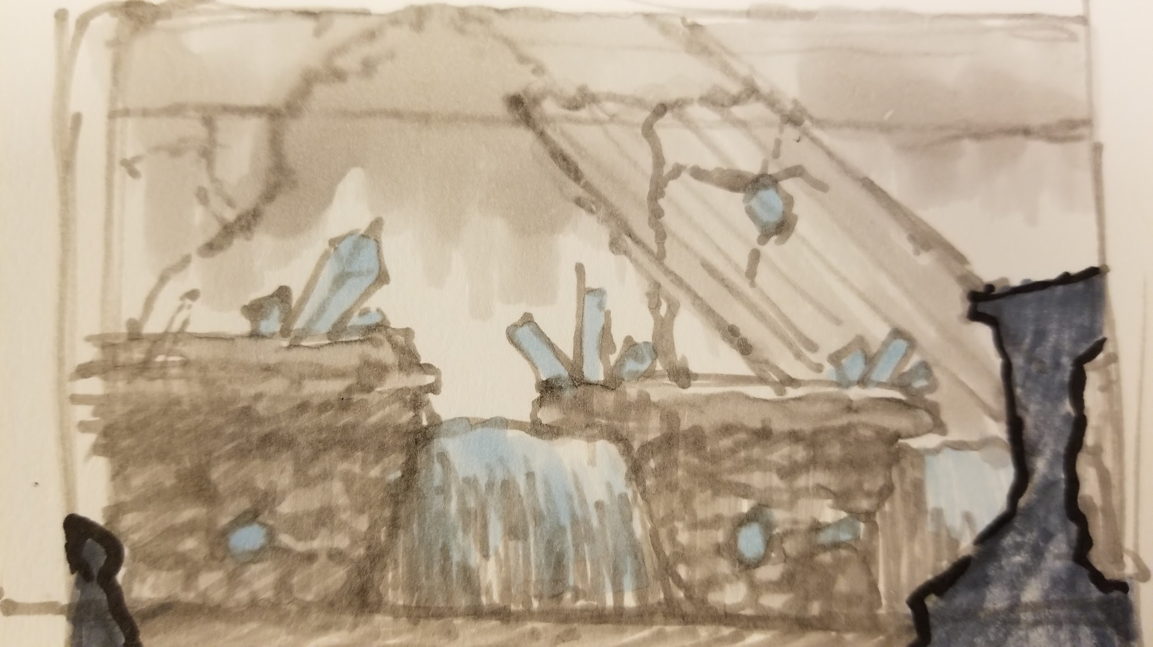
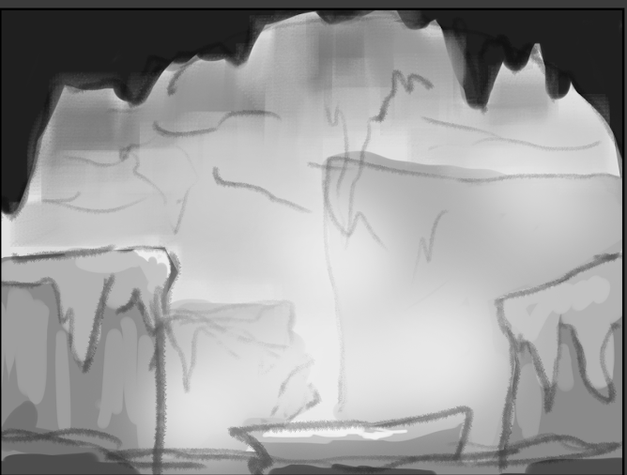
Environment Concept
Left pictures:
Thumbnails of background layouts with markers, planning out environments
Right pictures:
Strong focus on 3 values and lighting through the parallaxing layers
Notes:
Left pictures: thumbnails of background layouts with markers, planning out environments
Right pictures: strong focus on 3 values and lighting through the parallaxing layers

Slide 19

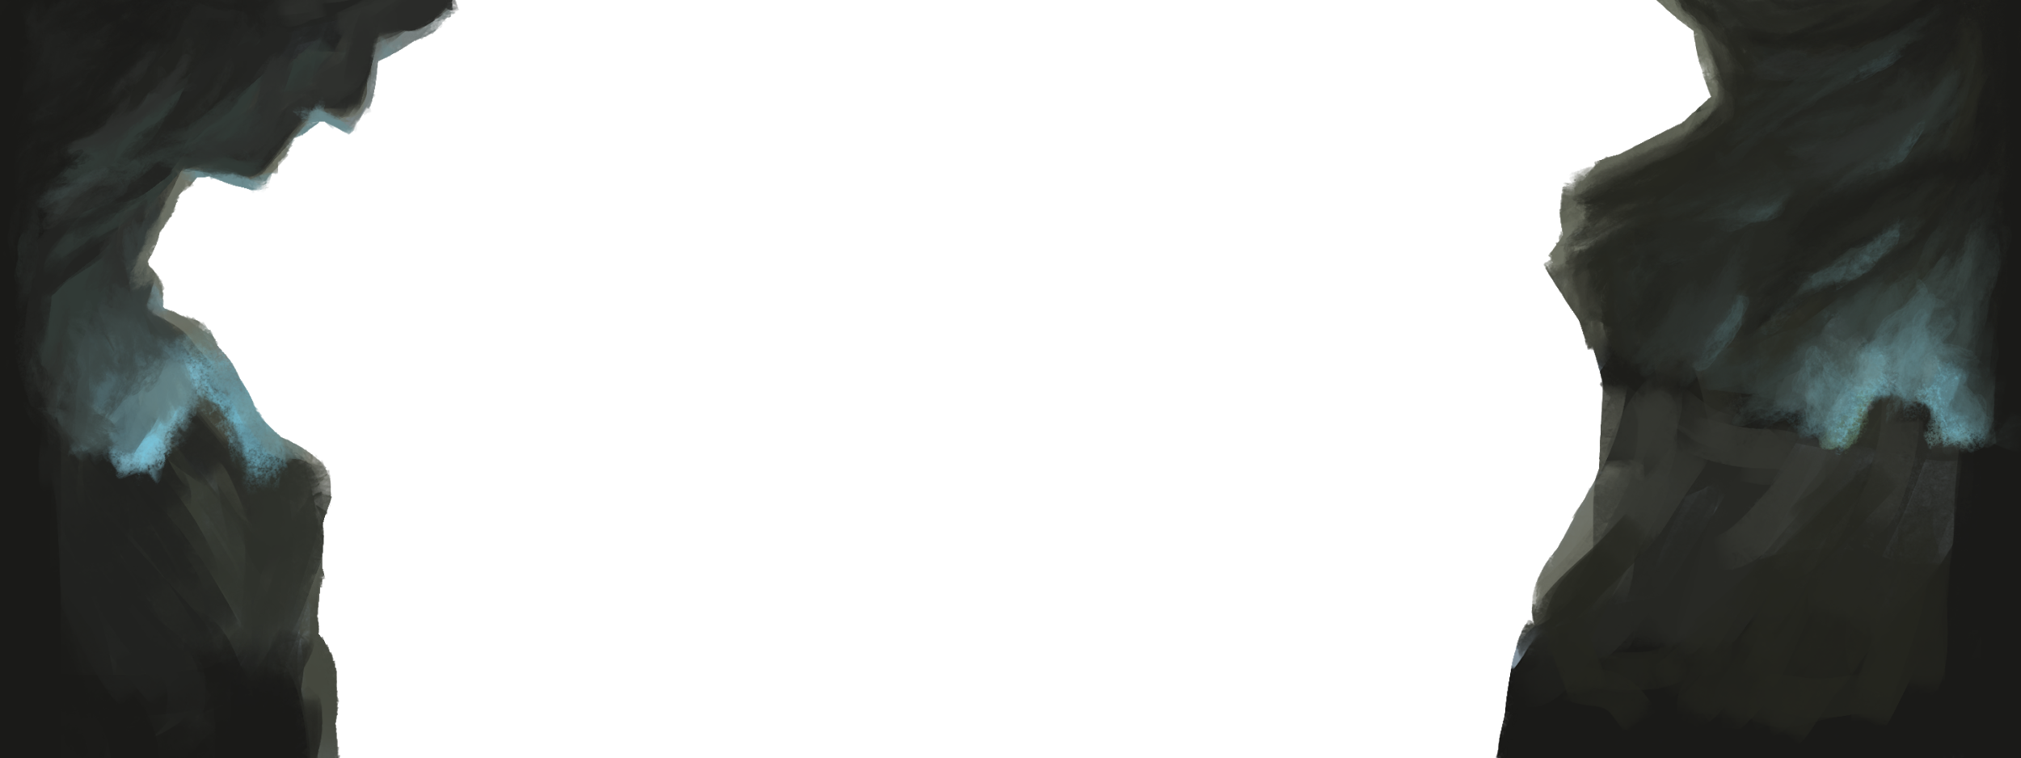
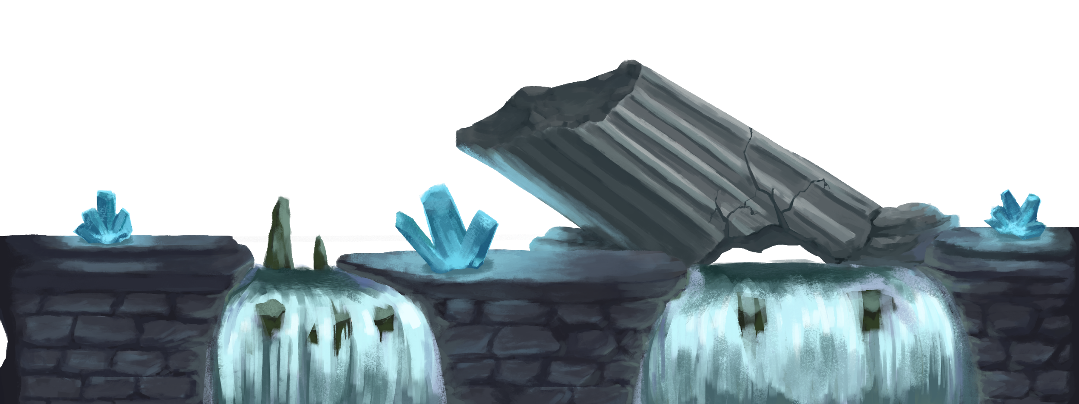
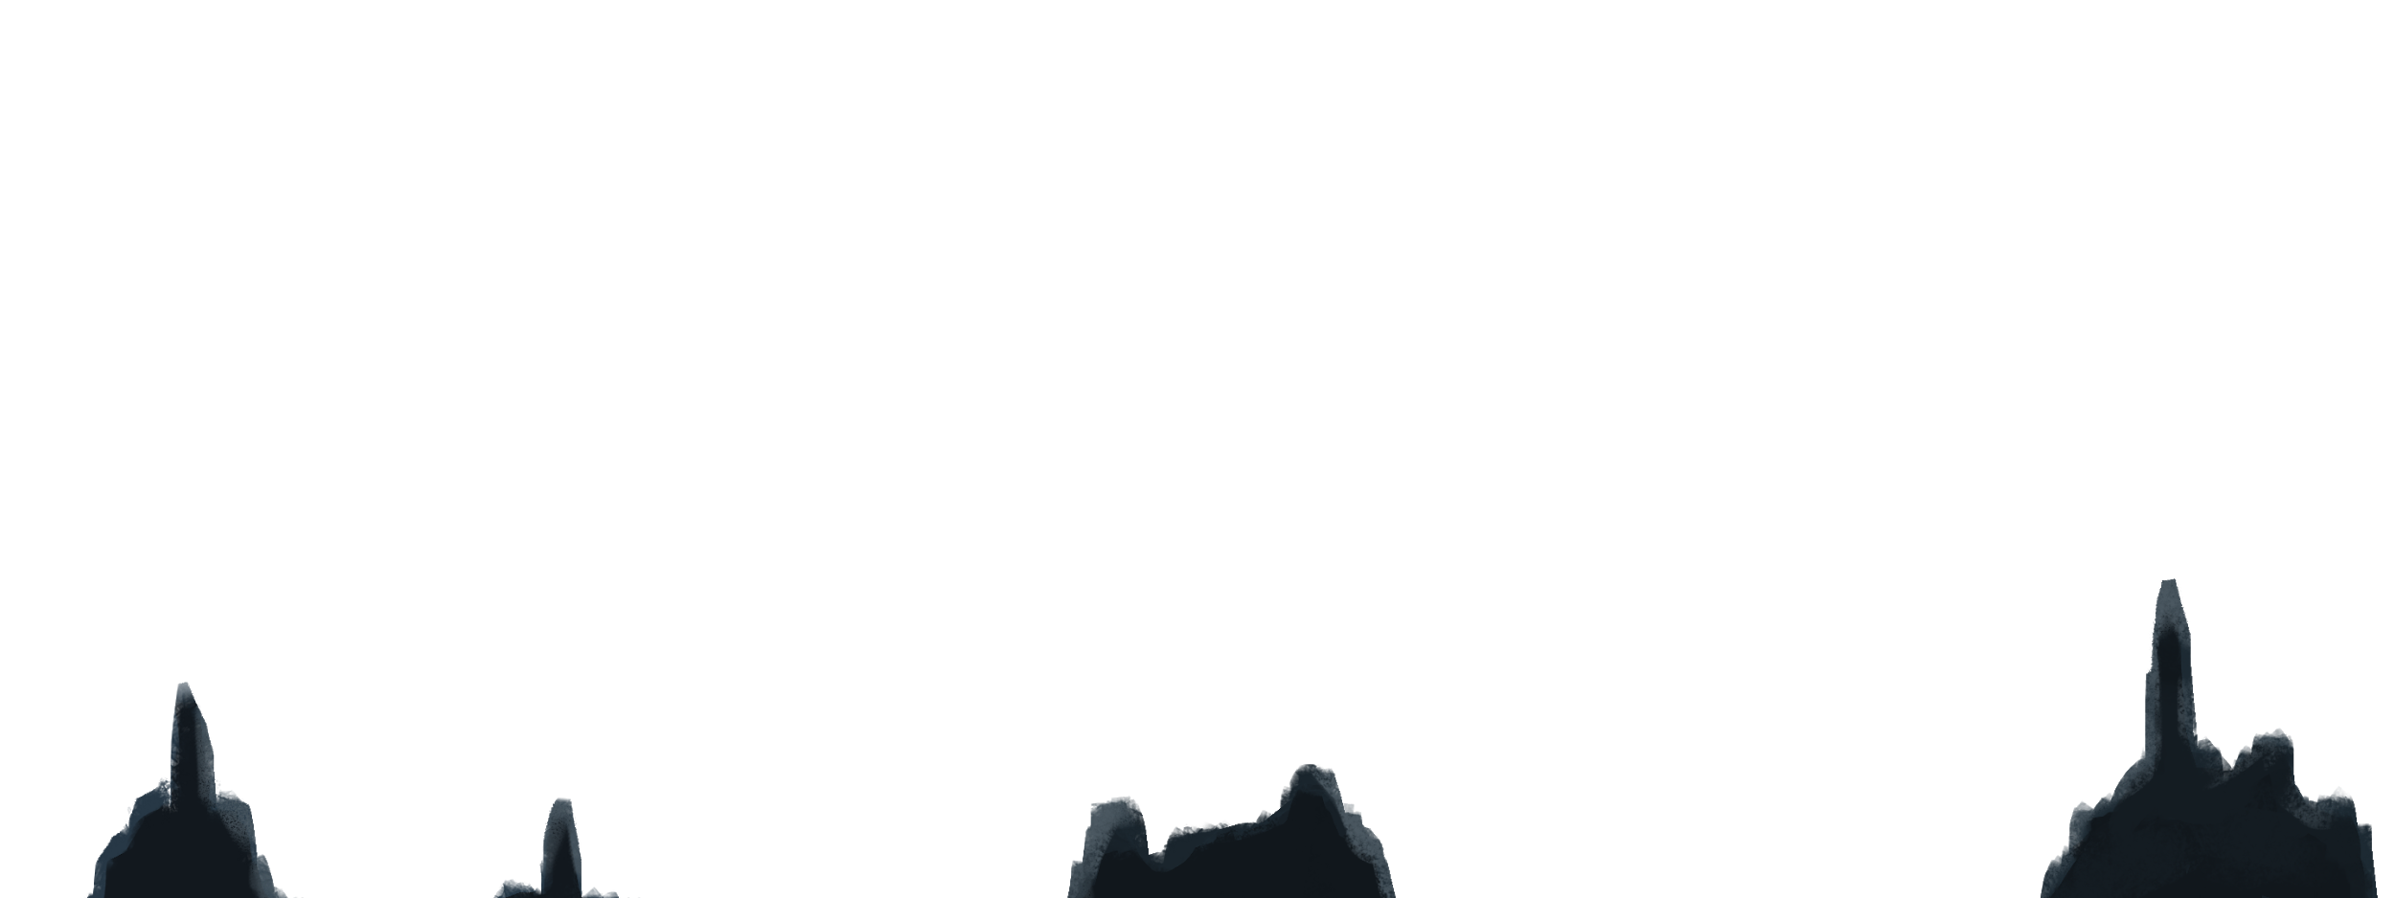
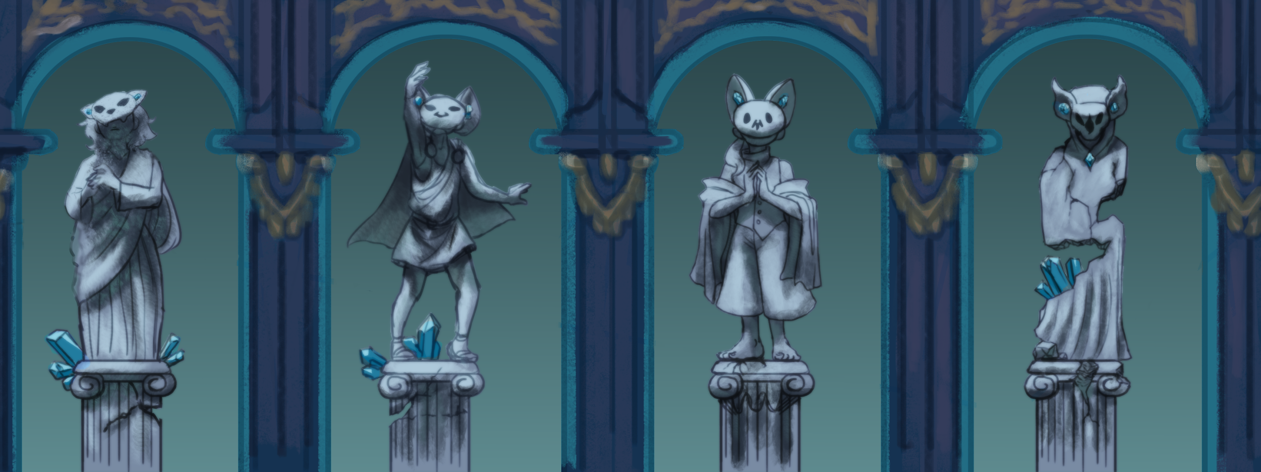
Environment Asset
Color palette: desaturated greens, yellow, blues, and purples
Avoiding saturated red, orange, yellow colors to avoid blending in with characters and interactable props
Background layers cut up and adjusted in engine for parallaxing effect
Notes:
-Color palette: desaturated greens, yellow, blues, and purples
-Avoiding saturated red, orange, yellow colors to avoid blending in with characters and interactable props
-Background layers cut up and adjusted in engine for parallaxing effect

Slide 20
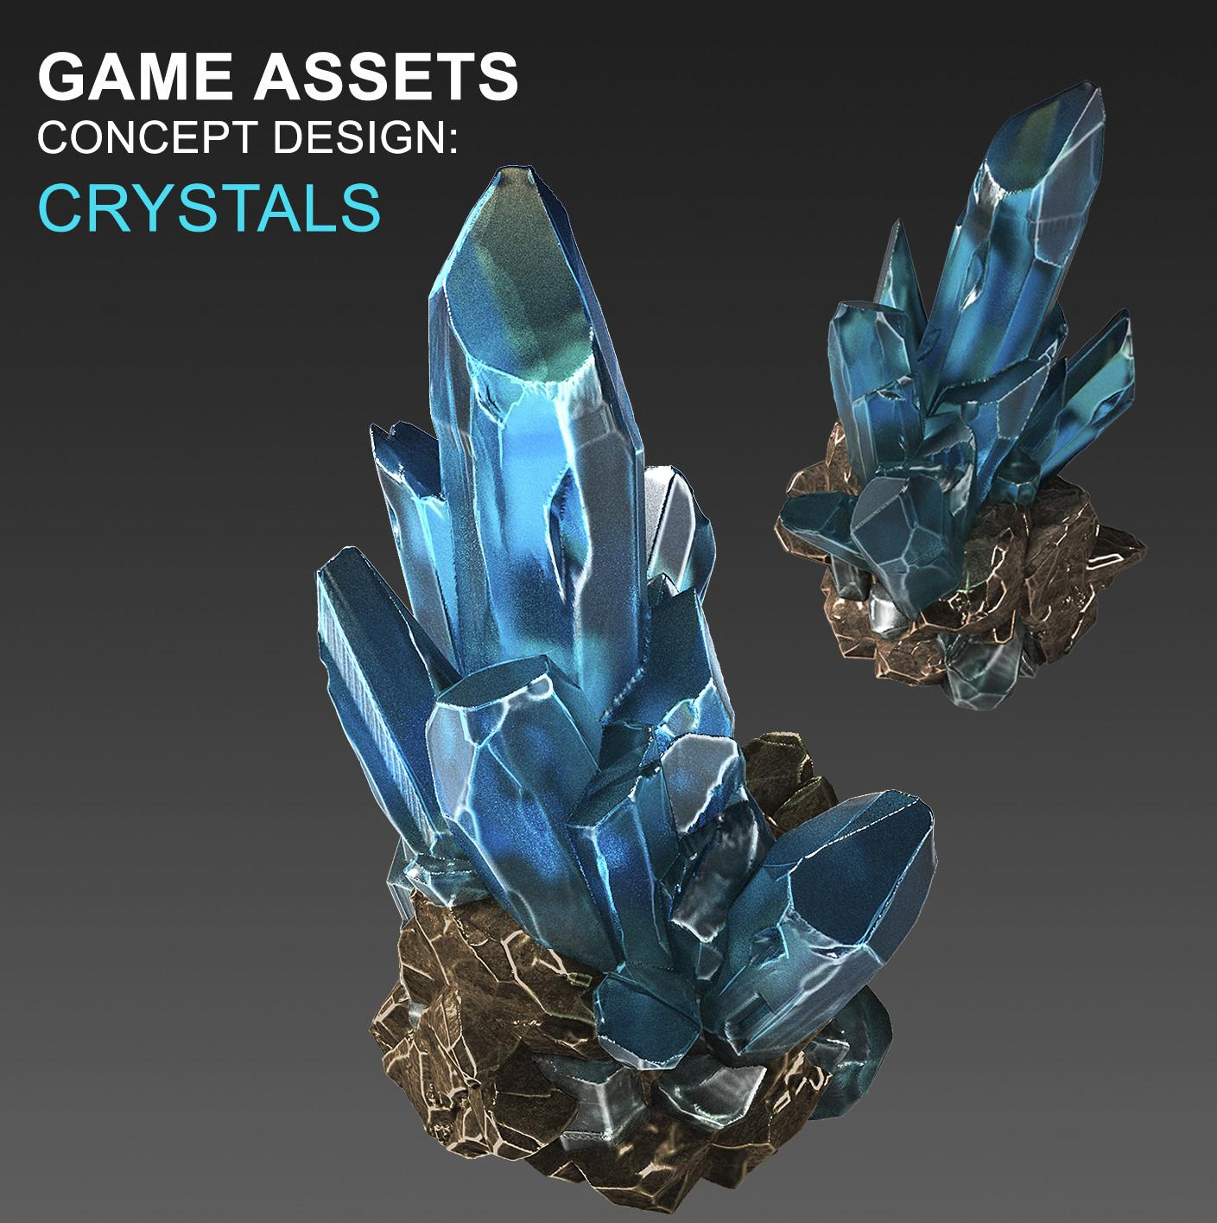
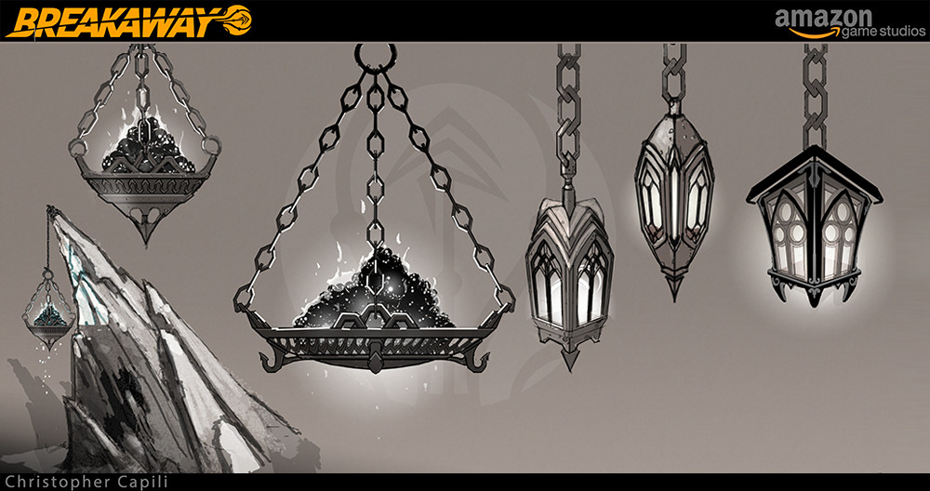
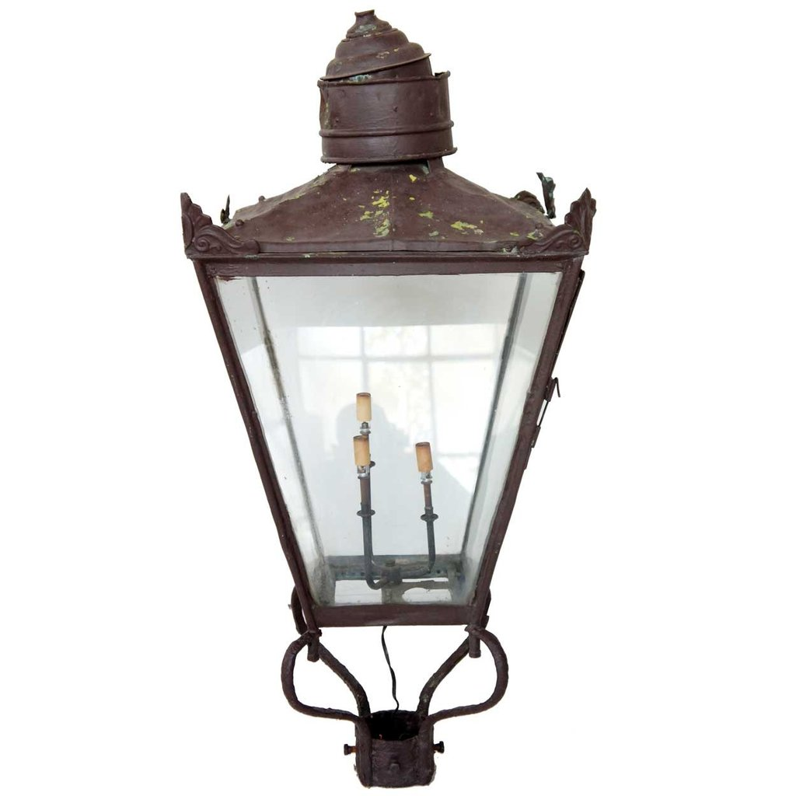
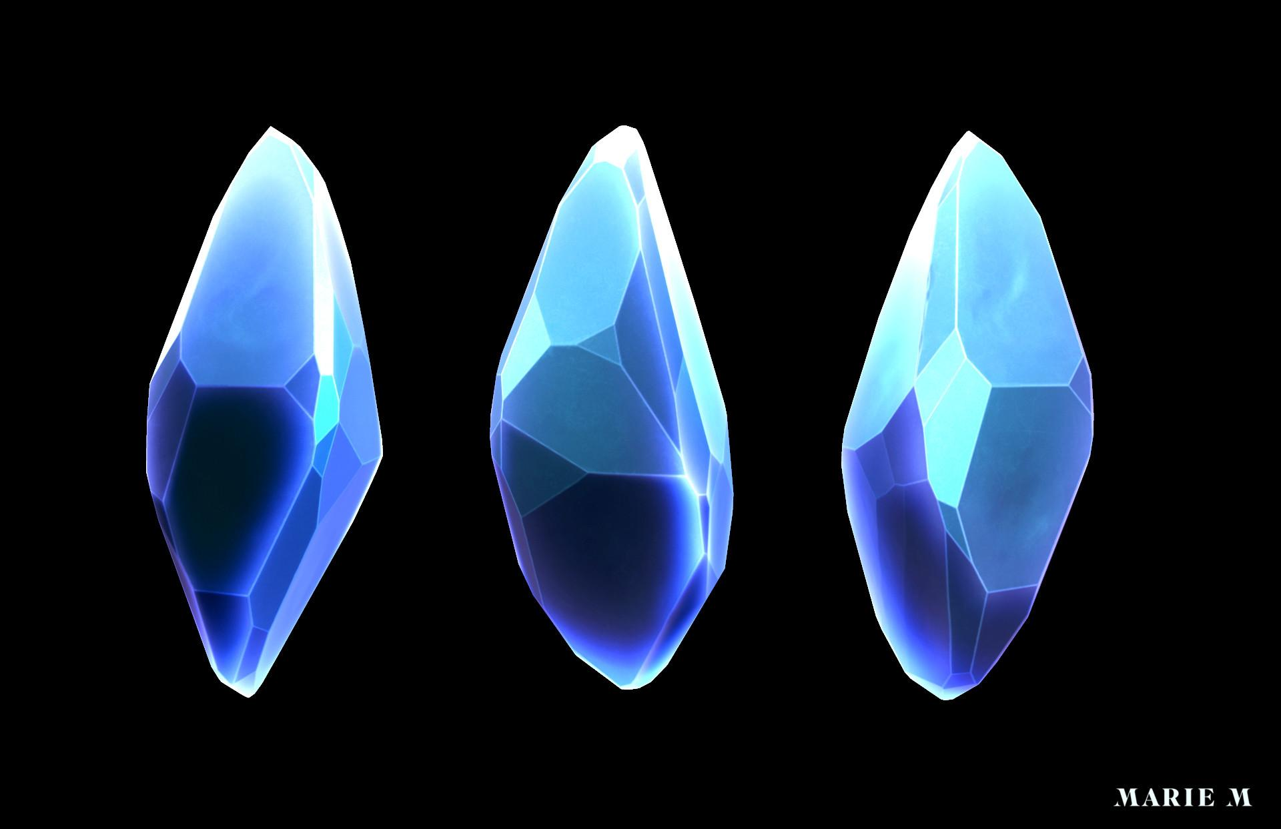
Prop References
“Interactable”
We want to keep the culture aspect of the ruins to be relatively vague. so for the ruins, they are Greek inspired with Victorian elements.
@BreakawayDreadshore_ChristCapili_2017
@CrystalConcept_OlesiaGoiko_2016
@FFInspiredCrystal_MarieMichelle_2016

Slide 21
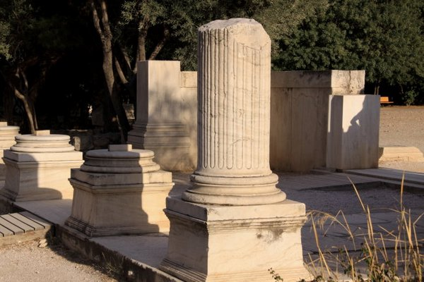

Prop References
“Non - Interactable”
@Acropolis, Greece_Zhou Mei_2010
@Rayman Legends_Ubisoft Montpellier_2013
Similar to background, with focus on painting style to distinguish from interactable props
Notes:
Similar to background, with focus on painting style to distinguish from interactable props

Slide 22







Prop Concepts
Platforms
Lantern
Brazier
Most of the ruin’s architecture is Greek inspired, while most of the props are Victorian inspired.
Notes:
Description needed

Slide 23













Prop Assets
“Modular”
They’re not necessarily tiled but these assets can be repeated or place on top of another without creating inconsistencies.
With the rocks, it can be rotated and scaled so the environment doesn’t feel bland.

Slide 24




Prop Assets
“Interactable”
The lantern serves as a safe zone for the character. Creatures can’t enter the places that are lit by the lantern.
Lantern
Brazier
Crystal Collectables
These crystals is what the players collect throughout the game, getting stronger as more crystals are collected.
The brazier serves as the end goal for the game. For when the player lights it with the crystal collectibles.

Slide 25



VFX References
@FinalFantasy10_SquareEnix_2001
@Fire_HeliKosunen_2015
Final Fantasy X was used for as inspiration for when the creatures are defeated.
The wisp is used for inspiration for the creatures.
@IOSSummerAcademy_MakeSchool_2017

Slide 26

VFX Concepts
The flames are hand animated, so the flow doesn’t feel forced.
The flames are stylized to give it a mystical feeling.
It is in grayscale so the colors can be changed at will.

Slide 27




UI References
Since it’s an action-packed game, the UI will be kept simple so there’s clarity.
Many fantasy UIs where used so when for making the UI, the game still looks inviting to play despite the horror aspect.
Many fantasy games uses acanthus leaves for the design.
@FantasyUI_RobHayes_2015
@HPBar_DamienRichard_2018
@SuperSmashBrosWiiU_Nintendo_2014

Slide 28




UI Concepts
Every time the player gets hit,
they lose a heart.
This serves as an energy meter. The flame grows which each crystal you collect.

Slide 29



Font

Slide 30

Camera
The camera follows the player and slightly trails behind them. There’s a bounding box that prevents the camera from moving too far.

